Slide 1

Welcome to
‘Meet the Teacher’
Year 6
Notes:
SW

Slide 2

Agenda
The Team
Our expectations & values
Reminders
Thrive approach to rewards and sanctions
Uniform
What we are learning about this year
Curriculum and SATs
How you can help your child?
Positive parent/school partnership
Notes:
SW

Slide 3

The Year 6 team
Year 6 Class teachers:
Mrs Priest, Mrs Beusmans
Mr Wakeford, Mrs Smalley
Teaching Assistants for Year 6:
Miss Omar
Mrs Lammas
Mrs Parker
Notes:
SW

Slide 4




Pencil Cases - Thank you!
Inside the pencil case please provide your child with the following equipment and all will need to be labelled with your child’s name:
2 x standard HB pencils
1 x whiteboard marker pen
1 x glue stick
1 x blue writing pen (no biro and should be a standard blue in colour)
1 x purple biro
1 x Ruler that can fit inside their pencil case.
Behaviour
Learning
Role model
Notes:
TB

Slide 5
Our Expectations and Values
HEART Values are at the core of everything we do, in our behaviour, our learning and our Curriculum.
Honesty
Excellence
Attitude
Respect
Thoughtfulness
Behaviour
Learning
Role model
Notes:
AP

Slide 6
Our Expectations
Reading at least four times a week (focus book)
Spellings- given out each Tuesday- weekly test to check on the following Friday.
Times tables- the Government expectation is that all children should know all multiplication tables up to 12 x 12 by the summer term of Year 4.
Weekly maths homework, out on a Thursday back in on the following Tuesday. This will begin this week.
We will communicate with you if we are concerned with the completion and standard of your child’s homework. It should be completed to the best of their ability and recorded using a handwriting pen or in pencil.
Behaviour
Learning
Role model
Notes:
AP

Slide 7

Reminders
Home School Diaries for communication and also to support your child with their learning in school and at home.
Coloured Book Banded or Phonic scheme books (fluency/comprehension book- child to read to you) and their own library book (sharing book- this can be read by adult or child together for pleasure). These can be changed frequently, but the levels don’t change as often as previous years.
Reward and sanctions system- We are a Thrive based school and this is reflected in how we support children to learn from all experiences.
Rewards:
House points- children are awarded House points for their behaviour and manners and consideration for others around the school and displaying effort in their learning. When children get enough House points, they can exchange them for a reward.
Class HEART, children will have the opportunity to work together to fill their HEART and be rewarded, once it is full with additional class rewards such as outdoor game, board games, drawing etc
House team afternoon for the winning House at the end of each term.
Praise postcards, weekly ‘Learner of the Week’ certificate, Headteacher award as well as regular communication with you.
HEART Awards & badges- These are awarded termly and are recognised for Behaviour, Learning and being a Role Model.
Notes:
GS

Slide 8
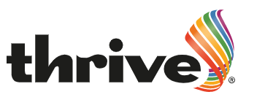
Being a Thrive school and appropriate sanctions
Support from all adults in helping to work through problems- common language and approach used across the school.
Restorative resolutions, the school has moved away from old school approaches.
Dedicated pastoral team within school including trained Thrive practitioner & ELSA.
Sanctions within class:
Verbal reminder
Name on board- reminder of expectations and breaktime meet with teacher to reflect.
One tick- Behaviour or disruption continues- into the consequence book- they will visit this session at lunchtime with a member of the leadership team to reflect on choice and move to partner class.
Sanctions at break & lunchtime:
The child will be reminded of behaviour expectations
Stay with staff member to talk and calm
Removed from playtime
If your child refuses to come to a Consequence Room, then parents will need to attend this with their child after school.
Notes:
GS

Slide 9
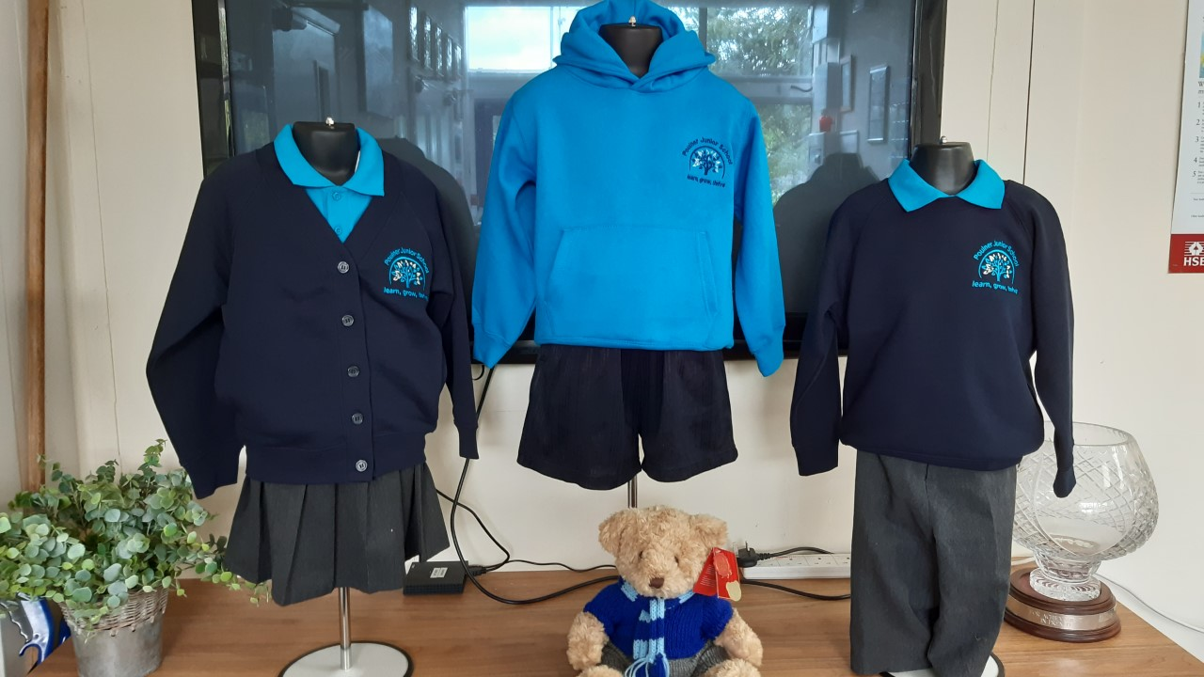

Uniform
PE days- PE kits to be worn for the whole day
Specific safety equipment e.g. gum shields, shin pads
The PE hoodie should not be worn with the
classroom uniform , it is for PE days only.
Year 6 days are:
Kidston - Monday and Wednesday
Picasso - Wednesday and Friday
Hair tied back, no nail varnish, no fashion hair cuts, small studs only, school uniform at all times, school shoes- NOT trainers unless it is a PE day
Please could your child bring in an old shirt to be used as their Art shirt
We will be learning outside whatever the weather, so we would ask that your child always has a waterproof coat and we will let you know when they will need their wellies.
Notes:
TB

Slide 10


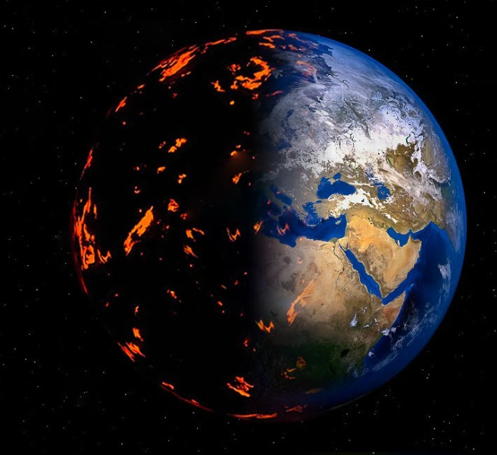

Our Topics this year
Ancient Greece
Marvellous Mayans
Our Fragile Planet
Where does chocolate come from?
Transition
Notes:
TB

Slide 11
Opportunities for this Year
Clubs for lunchtime and after school
Inter-house competitions- increased opportunities
Sports opportunities and competitions against other schools
Lunchtime gardening/Eco
John Muir Award
House Captains
School Council
Trips:
PGL – Osmington Bay – Monday 21st October - Friday 25th October
Final Information Evening: Wednesday 25th September, 6.30pm, online
Other dates for your diary:
SATS information evening – TBC
Any other dates for your diary will be confirmed throughout the year.
Notes:
SW

Slide 12

Being Role Models and taking on responsibility
House Captain Elections- anonymous and due in this week, the rest of the school will then hear the letters/manifesto and decide on their favourite. Voting will be on Friday 27th September.
Many other opportunities:
School Council
Office monitors
Class monitors
Library
Notes:
AP

Slide 13
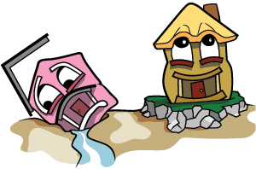
SATs - They really need secure foundations!
SATs- why??
First safe opportunity for children to succeed in a test situation
Secure foundations/basics of learning ready for secondary school
Chance to learn revision techniques
For their own self esteem and pride in their learning
Government measure of school’s work
Believe it or not children find this year and the process of SATs extremely positive and they are always really proud of themselves.
Best advice- Reward the effort between now and May, not the result in July!
Notes:
TB

Slide 14
How it all works!
First assessment week- 7th October
From this teaching will be tailored to close gaps and teach specifics so that they are more secure in their learning.
Revision guides and work books will be issued after half term and are used to give guidance and set weekly pages as part of Home Learning.
There are two sets that are issued- Expected level and Higher level (these do not put a ceiling on what they can achieve)
Second assessment week in January 2025
From this teaching will be tailored again to close any remaining gaps and teach specifics so that they are more secure in their learning.
We will share with you their results.
Children will be invited to Booster sessions - these are good fun, supportive and something positive.
Rehearsal week- in March 2025
SATs week – 12th May 2025- 100% attendance is required, no leave of absence will be approved.
Notes:
GS

Slide 15

Emotional wellbeing- How can you help your child?
Be positive with them, and always try and ask what positive things have happened in the day.
Keep their time limited on social media, online and gaming- too much time is really not good and they do need to have time away from screens and devices and engage them in other things.
Check their phones and online activity- Year 6- children are often allowed on sites that are not appropriate and the messaging that they send to each can often be quite shocking and unpleasant. This is not school’s job to monitor.
If they are asking for a phone, just consider if they need it? If they don’t, then don’t!
Make sure they get enough sleep, take phones and devices out of rooms, especially at night or take the power lead off if its easier!
Don’t believe them when they tell you everyone is doing what they want to do!
Listen to them and any worries, but also trust the teachers and adults in school.
If you are able to, please get involved in school life, support trips, PTA events, whole school events, parent helper- hear readers or help in class.
Notes:
GS

Slide 16

Positive Parent/School Partnership
Come and see us if you are worried/concerned- small problems are easier to solve. Don’t let them build!
Please use the correct lines of communication, speaking to the teacher to gain the full picture is vital, as we know that children often only share their view of an incident.
Facebook and WhatsApp groups are great, but can be used to voice inappropriate comments and slander towards the school and teachers on any platform, is not acceptable, please use these forums positively or to just clarify, share ideas! Mrs Randall will contact parents for a discussion if it comes to our attention that this is the case.
Please support us, all of your children are important to us, we always have their best interests at heart.
Use Parent Voice- our first one will be on Monday 30th September at 2pm this will be an opportunity for you to come in and meet with Mrs Randall to give feedback and ask questions, come along if you are interested.
SEND coffee mornings/afternoons- a chance to share ideas and support each other.
Opportunities for you to come in regularly- curriculum evenings, Book Looks, Outcome events, whole school events.
We also aim to put more onto the school’s website- so please look at the Year 5 area for photos or updates too!
Notes:
GS

Slide 17


Parent / grandparent readers – can you spare an hour a week?
We will need to get your DBS and give you some basic training
Zoom online training/induction - TBC
English Information Evening - Thursday 3rd October - 3.30pm and 6pm
Notes:
AP

Slide 18
What a great start! We cannot wait to work with you and your child this coming year.
We will always be here to listen, help and support!

