Slide 1

Welcome to
‘Meet the Teacher’
Year 5

Slide 2

Agenda
The Team
Our expectations & Values
Reminders
Thrive approach to Rewards and sanctions
Uniform
What we are learning about this year
How you can help your child?
Positive parent/school partnership

Slide 3

The Year 5 team
Year 5 Class teachers:
Miss Roots (Glennie)
Mrs Rosier (Sheeran)
Teaching Assistants for Year 5:
Mrs Bourne, Mrs White,
Mrs Cuddy, Ms Wheeler

Slide 4



Our Expectations and Values
HEART Values are at the core of everything we do, in our behaviour, our learning and our Curriculum.
Honesty
Excellence
Attitude
Respect
Thoughtfulness
Behaviour
Learning
They are now Upper school, so we expect them to be great role models to the younger children.
Role model

Slide 5

Pencil Cases - Thank you!
Inside the pencil case please provide your child with the following equipment and all will need to be labelled with your child’s name:
2 x standard HB pencils
1 x whiteboard marker pen
1 x glue stick
1 x blue writing pen (no biro and should be a standard blue in colour)
1 x purple biro
1 x Ruler that can fit inside their pencil case.
If your child has other items in their pencil case, we will ask them to remove them.
Behaviour
Learning
Role model

Slide 6
Our Expectations
Reading at least four times a week (focus book)
Spellings- given out each Tuesday- homework due back following Tuesday and test the next week.
Times tables- the Government expectation is that all children should know all multiplication tables up to 12 x 12 by the summer term of Year 4. Still a big focus in year 5.
Weekly maths homework, out on a Thursday back in on the following Thursday.
We will communicate with you if we are concerned with the completion and standard of your child’s homework. It should be completed to the best of their ability and recorded using a handwriting pen or in pencil.
Behaviour
Learning
Role model

Slide 7

Positive behaviour expectations
Consistency and nurture are fundamental to the school’s approach.
The children are responding well to hands up for quiet, and reminders through language including:
‘Eyes on me’
‘Empty hands’
Notes:
LRD

Slide 8

Reminders
Home School Diaries for communication and also to support your child with their learning in school and at home.
Coloured Book Banded and their own library book (sharing book- this can be read by adult or child together for pleasure). These can be changed frequently, but the levels don’t change very often.
Reward and sanctions system- We are a Thrive based school and this is reflected in how we support children to learn from all experiences.
Rewards:
House points- children are awarded House points for their behaviour and manners and consideration for others around the school and displaying effort in their learning. When children get enough House points, they can exchange them for a reward.
Class HEART, children will have the opportunity to work together to fill their HEART and be rewarded, once it is full with additional class rewards such as parachute game time, board games, drawing etc
House team afternoon for the winning House at the end of each term.
Weekly ‘Learner of the Week’ certificate, Headteacher award as well as regular communication with you.
HEART Awards & badges- These are awarded termly and are recognised for Behaviour, Learning and being a Role Model.

Slide 9

Being a Thrive school and appropriate sanctions
Support from all adults in helping to work through problems- common language and approach used across the school.
Restorative resolutions, the school has moved away from old school approaches.
Dedicated pastoral team within school including trained Thrive practitioner & ELSA.
Sanctions within class:
Verbal reminder
Name on board- reminder of expectations, breaktime meet with teacher to reflect.
One tick- Behaviour or disruption continues- into the consequence book- they will visit this session at lunchtime with a member of the leadership team to reflect on choice and move to partner class.
Sanctions at break & lunchtime:
The child will be reminded of behaviour expectations
Stay with staff member to talk and calm
Removed from playtime
If your child refuses to come to a Consequence Room, then parents will need to attend this with their child after school.

Slide 10
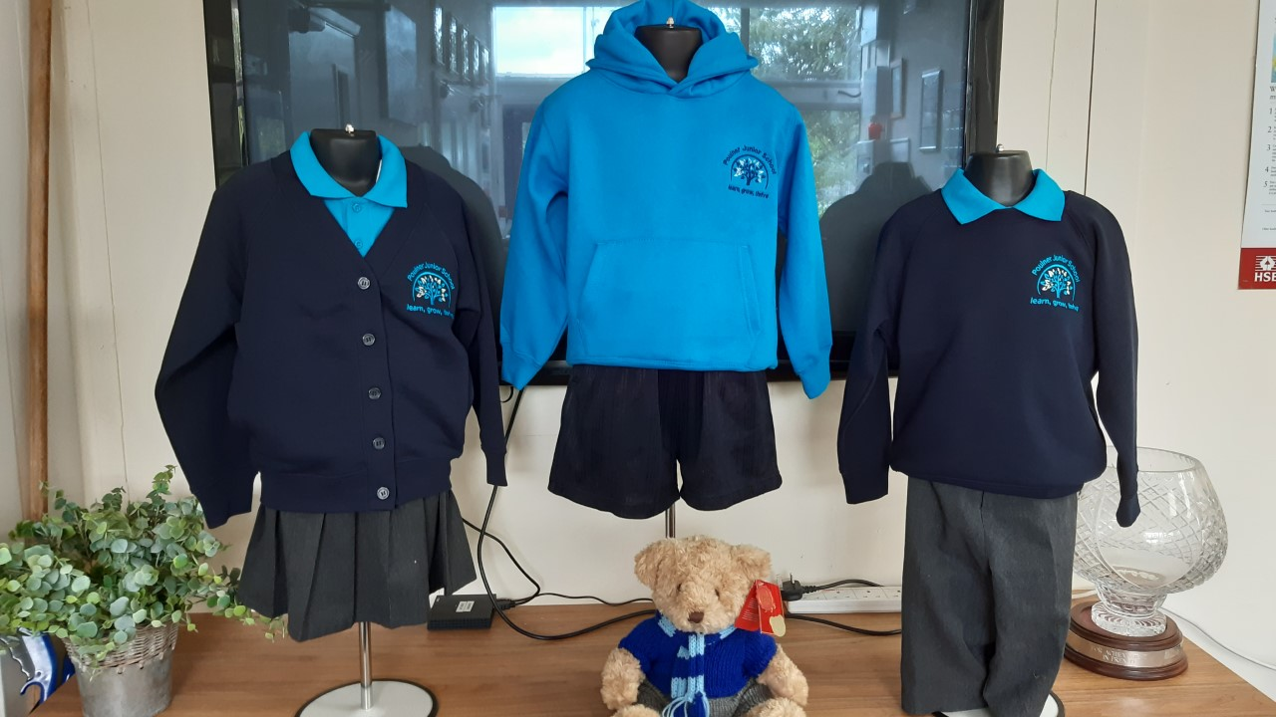

Uniform
PE days- PE kits to be worn for the whole day
Specific safety equipment e.g. gum shields, shin pads
The PE hoodie should not be worn with the
classroom uniform , it is for PE days only.
Year 5 days are:
Glennie: Monday & Wednesday
Sheeran: Tuesday & Wednesday
Hair tied back, no nail varnish, no fashion hair cuts, small studs only, school uniform at all times, school shoes- NOT trainers unless it is a PE day.
Please could your child bring in an old shirt to be used as their Art shirt
We will be learning outside whatever the weather, so we would ask that your child always has a waterproof coat and we will let you know when they will need their wellies.

Slide 11
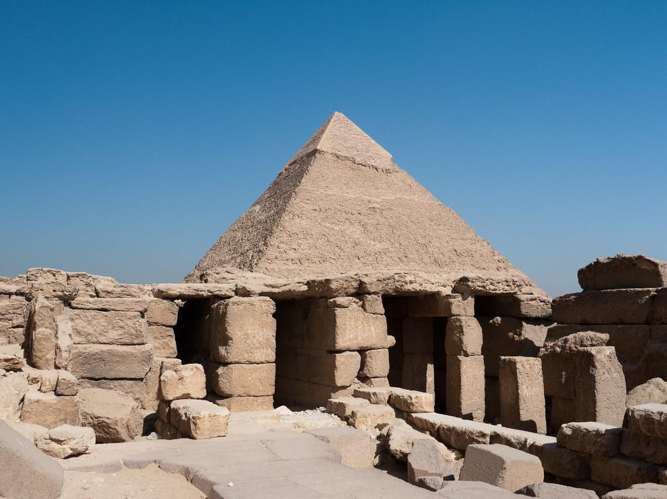



Our Topics this year
Amazing Amazon, Brilliant Brazil
Tombs, temples and treasures
Beyond Face Value
Ringwood Remembers

Slide 12
Day to day arrangements
Attendance- If your child is not in then you will receive a phone call from the office enquiring about their whereabouts. Please ring in or email in to let us know if your child is unwell or not attending school for any reason. If we do not hear from you by 11am then you will receive a home visit by the school leadership team.
School lunches, Breakfast Club & JASPA need to be paid for prior to use. A maximum £10 credit can be applied. If you go above this will we refuse dinners and ask that you bring in a packed lunch or refused a place at Breakfast Club/JASPA.
Home School diary is for brief learning comments or enquiries- they will not become a long dialogue- we would rather you came in and made an appointment to discuss progress and any concerns with the class teacher. These diaries will be checked at least once a week and signed by an adult, if you have a message in there, please make sure this is flagged to the teacher or SLT member on the gate in the morning.
Drinks bottle that is ideally non-drip, named and must contain only water
Healthy snack only at breaktime- piece of fruit, cheese, dried fruit, cereal fruit bars, but please check these- NO NUTS!
Arriving and leaving school -SLT member will welcome your child on a morning and the class teacher will bring them out to you. Year 3 children enter and exit by the swimming pool/courtyard gate.
Clubs a letter will be sent out shortly of clubs available this term. Wherever possible we do not cancel clubs. A release date is given for you to book.
Newsletters come out fortnightly.
Notes:
GS

Slide 13
Opportunities for this Year
Clubs for lunchtime and after school
Inter-house competitions- increased opportunities
Sports opportunities and competitions against other schools
Lunchtime gardening/Eco
John Muir Award
Trips: Zoolab- happened today!
Forest Adventure, WW2 walk and residential camp-
Blunts Barn - July 2027
Other dates for your diary will be confirmed throughout the year.

Slide 14



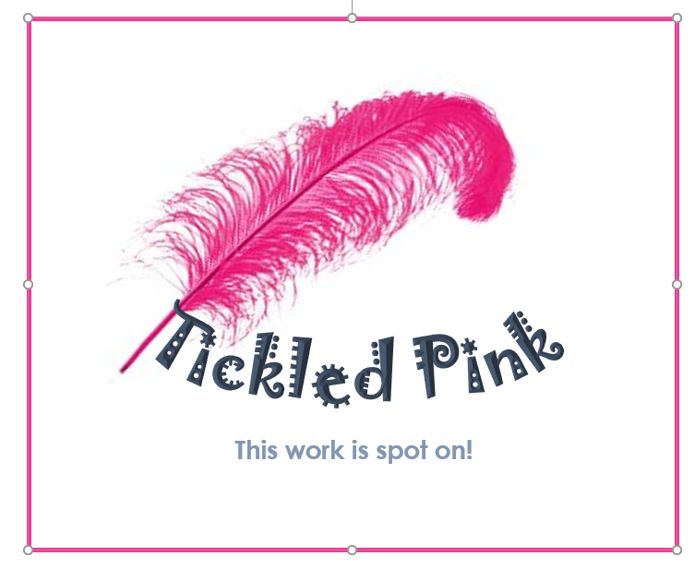

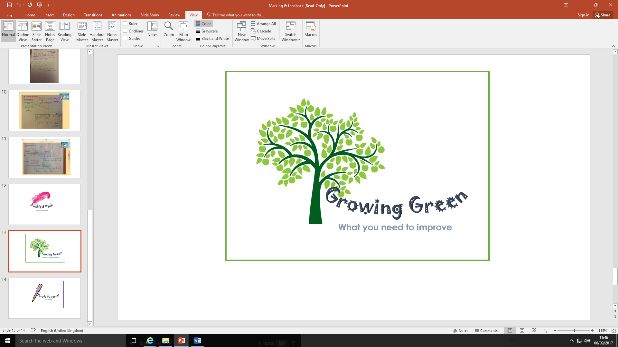
Marking
Responsive feedback and marking in class during the lessons.
Less written comments and more verbal discussions.
Children given time to correct in purple editing pens.
Teachers will mark using a pink highlighter for learning that
your child has successfully achieved and understood (tickled pink).
Teachers will mark development points or aspects for the children to revisit/correct in the lesson using a green highlighter (green for growth).
Notes:
AP

Slide 15

Emotional wellbeing- How can you help your child?
Be positive with them, and always try and ask what positive things have happened in the day.
We encourage you not to give your child a smart phone. Only brick phones are allowed in school. All local schools are supporting the campaign to remove/reduce access that children have to social media and online gaming/communities..
If they do have access to a smart phone check their phones and online activity- Year 5- children are often allowed on sites that are not appropriate and the messaging that they send to each can often be quite shocking and unpleasant. This is not school’s job to monitor.
If they are asking for a phone, just consider if they need it? If they don’t, then don’t!
Make sure they get enough sleep, take phones and devices out of rooms, especially at night or take the power lead off if its easier!
Don’t believe them when they tell you everyone is doing what they want to do!
Listen to them and any worries, but also trust the teachers and adults in school.
If you are able to, please get involved in school life, support trips, PTA events, whole school events, parent helper- hear readers or help in class.
NO SMART PHONES OR SMART WATCHES ALLOWED IN SCHOOL
Notes:
GS

Slide 16

Positive Parent/School Partnership
Come and see us if you are worried/concerned- small problems are easier to solve. Don’t let them build!
Please use the correct lines of communication, speaking to the teacher to gain the full picture is vital, as we know that children often only share their view of an incident.
Facebook and WhatsApp groups are great, but can be used to voice inappropriate comments. Any slander towards the school or teachers on any platform, is not acceptable, please use such forums positively or to just clarify and share ideas! Mrs Randall will contact parents for a discussion if it comes to our attention that this is the case.
Please support us, all of your children are important to us, we always have their best interests at heart.
SEND coffee mornings/afternoons- a chance to share ideas and support each other.
Opportunities for you to come in regularly- curriculum evenings, Book Looks, Outcome events, whole school events.
We also aim to put more onto the school’s website- so please look at the Year 5 area for photos or updates too!
Friends of Poulner AGM - Wednesday 2nd October 7pm in the Community Room.

Slide 17



Parent / grandparent readers – can you spare an hour a week?
We will need to get your DBS and give you some basic training.
Zoom online training/induction Monday 30th September 7:30-8.30pm
Year 5 information evening on Osmington residential for their Year 6 trip.
Notes:
AP

Slide 18
What a great start! We cannot wait to work with you and your child this coming year.
We will always be here to listen, help and support!

