Slide 1

Welcome to
‘Meet the Teacher’
Year 4
Notes:
AP

Slide 2

Agenda
The Team
Our expectations & Values
Reminders
Thrive approach to Rewards and sanctions
Uniform
What we are learning about this year
How you can help your child?
Positive parent/school partnership
Hooke Court trip
Notes:
AP

Slide 3

The Year 4 team
Year Class teachers:
Mrs Priest & Mr Gavin
Mrs Hockley
Teaching Assistants for Year 4
Miss Omar, Miss Stephenson, Mrs Wyatt, Mrs Abley
Notes:
TH

Slide 4



Our Expectations and Values
HEART Values are at the core of everything we do, in our behaviour, our learning and our Curriculum.
Honesty
Excellence
Attitude
Respect
Thoughtfulness
Behaviour
Learning
Role model
Notes:
WG

Slide 5

Pencil Cases - Thank you!
Inside the pencil case please provide your child with the following equipment and all will need to be labelled with your child’s name:
2 x standard HB pencils
1 x whiteboard marker pen
1 x glue stick
1 x blue writing pen (no biro and should be a standard blue in colour)
1 x purple biro
1 x Ruler that can fit inside their pencil case.
If your child has other items in their pencil case, we will ask them to remove them.
Behaviour
Learning
Role model
Notes:
TH

Slide 6
Our Expectations
Reading at least four times a week (focus book)
Spellings- given out each Tuesday- weekly test to check on the following Friday.
Times tables- the Government expectation is that all children should know all multiplication tables up to 12 x 12 by the summer term of Year 4. (more to follow on this later)
Weekly maths homework, out on a Thursday back in on the following Tuesday.
We will communicate with you if we are concerned with the completion and standard of your child’s homework. It should be completed to the best of their ability and recorded using a handwriting pen or in pencil.
Behaviour
Learning
Role model
Notes:
AP

Slide 7

Positive behaviour expectations
Consistency and nurture are fundamental to the school’s approach.
The children are responding well to hands up for quiet, and reminders through language including:
‘Eyes on me’
‘Empty hands’
Notes:
AP

Slide 8

Reminders
Home School Diaries for communication and also to support your child with their learning in school and at home.
Coloured Book Banded or Phonic scheme books (fluency/comprehension book- child to read to you) and their own library book (sharing book- this can be read by adult or child together for pleasure). These can be changed frequently, but the levels don’t change as often as previous years.
Reward and sanctions system- We are a Thrive based school and this is reflected in how we support children to learn from all experiences.
Rewards:
House points- children are awarded House points for their behaviour and manners and consideration for others around the school and displaying effort in their learning. When children get enough House points, they can exchange them for a reward.
Class HEART, children will have the opportunity to work together to fill their HEART and be rewarded, once it is full with additional class rewards such as parachute game time, board games, drawing etc.
House team afternoon for the winning House at the end of each term.
Praise postcards, weekly ‘Learner of the Week’ certificate, Headteacher award, as well as regular communication with you.
HEART Awards & badges- These are awarded termly and are recognised for Behaviour, Learning and being a Role Model.
Notes:
WG

Slide 9
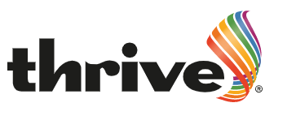
Being a Thrive school and appropriate sanctions
Support from all adults in helping to work through problems- common language and approach used across the school.
Restorative resolutions, the school has moved away from old school approaches.
Dedicated pastoral team within school including trained Thrive practitioner & ELSA.
Sanctions within class:
Verbal reminder
Name on board- reminder of expectations, break time meet with teacher to reflect.
One tick- Behaviour or disruption continues- into the consequence book- they will visit this session at lunchtime with a member of the leadership team to reflect on choice and move to partner class.
Sanctions at break & lunchtime:
The child will be reminded of behaviour expectations
Stay with staff member to talk and calm
Removed from playtime
If your child refuses to come to a Consequence Room, then parents will need to attend this with their child after school.
Notes:
AP

Slide 10
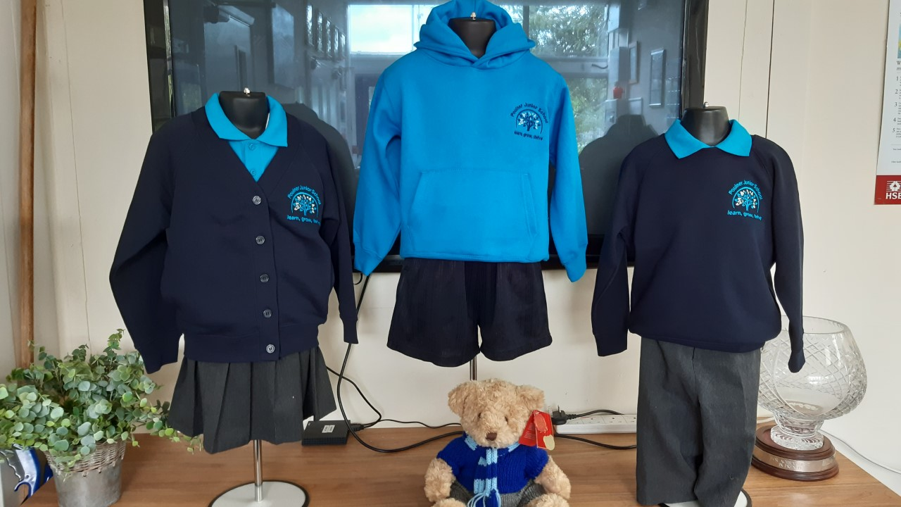

Uniform
PE days- PE kits to be worn for the whole day
Specific safety equipment e.g. gum shields, shin pads
The PE hoodie should not be worn with the
classroom uniform, it is for PE days only.
Year 4 days are: Tuesday & Thursday
Hair tied back, no nail varnish, no fashion hair cuts, small studs only, school uniform at all times, school shoes- NOT trainers unless it is a PE day
Please could your child bring in an old shirt to be used as their Art shirt
We will be learning outside whatever the weather, so we would ask that your child always has a waterproof coat and we will let you know when they will need their wellies.
Notes:
TH

Slide 11
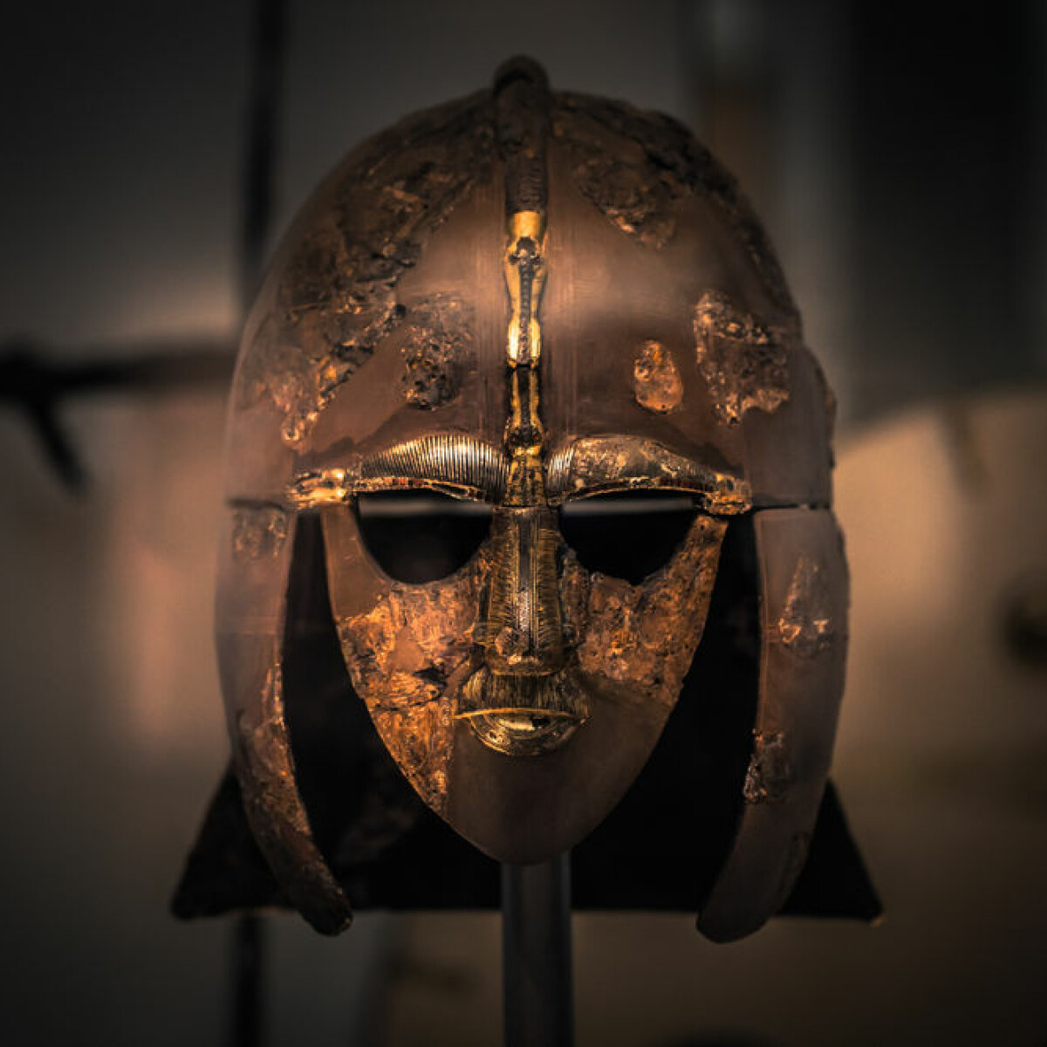



Our Topics this year
The Bold and the Brave
Raiders or Traders?
Living on the Edge
A Taste of Italy
Raging Rivers
Notes:
WG

Slide 12
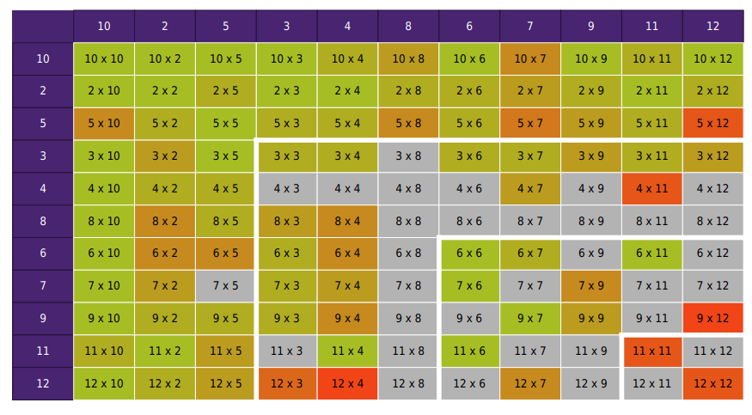
Focus on tables in order
Little and often – just one table at a time
Frequent revisits
Accuracy not just speed
Just For Year 4
End of year times table test
Notes:
WG

Slide 13
Opportunities for this Year
Clubs for lunchtime and after school
Inter-house competitions- increased opportunities
Sports opportunities and competitions against other schools
Lunchtime gardening/Eco
John Muir Award
Play Leader
Trips: Tuesday 10th – Wednesday 11th November Residential trip
to Hooke Court.
Other dates for your diary will be confirmed throughout the year.
Notes:
WG

Slide 14
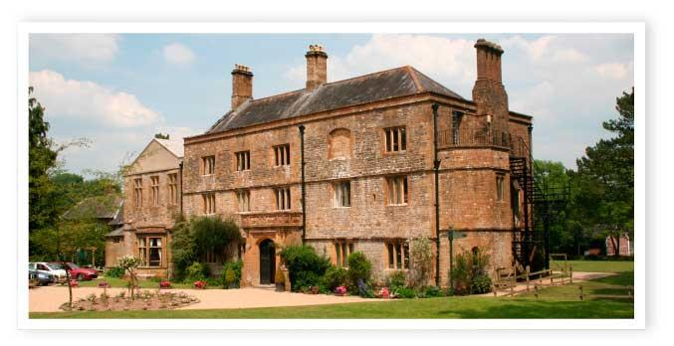
Y4 Viking Trip – Hooke Court
6th October - Final meeting Tuesday 3.30pm in the school hall.
Notes:
WG

Slide 15

Emotional wellbeing- How can you help your child?
Be positive with them, and always try and ask what positive things have happened in the day.
We encourage you not to give your child a smart phone. Only brick phones are allowed in school. All local schools are supporting the campaign to remove/reduce access that children have to social media and online gaming/communities..
If they do have access to a smart phone check their phones and online activity- Year 5- children are often allowed on sites that are not appropriate and the messaging that they send to each can often be quite shocking and unpleasant. This is not school’s job to monitor.
If they are asking for a phone, just consider if they need it? If they don’t, then don’t!
Make sure they get enough sleep, take phones and devices out of rooms, especially at night or take the power lead off if its easier!
Don’t believe them when they tell you everyone is doing what they want to do!
Listen to them and any worries, but also trust the teachers and adults in school.
If you are able to, please get involved in school life, support trips, PTA events, whole school events, parent helper- hear readers or help in class.
NO SMART PHONES OR SMART WATCHES ALLOWED IN SCHOOL
Notes:
AP

Slide 16

Positive Parent/School Partnership
Come and see us if you are worried/concerned- small problems are easier to solve. Don’t let them build!
Please use the correct lines of communication, speaking to the teacher to gain the full picture is vital, as we know that children often only share their view of an incident.
Facebook and WhatsApp groups are great, but can be used to voice inappropriate comments. Any slander towards the school or teachers on any platform, is not acceptable, please use such forums positively or to just clarify and share ideas! Mrs Walker will contact parents for a discussion if it comes to our attention that this is the case.
Please support us, all of your children are important to us, we always have their best interests at heart.
SEND coffee mornings/afternoons- a chance to share ideas and support each other.
Opportunities for you to come in regularly- curriculum evenings, Book Looks, Outcome events, whole school events.
We also aim to put more on to the school’s website- so please look at the Year 4 area for photos or updates too!
Notes:
AP

Slide 17
Positive Parent/School Partnership
Friends of Poulner AGM - Wednesday 14th October 7-9pm in the Community Room
.
Notes:
TH

Slide 18


Parent / grandparent readers – can you spare an hour a week?
We will need to get your DBS and give you some basic training
Google Meet (online) training/induction:
TBC
Notes:
AP

Slide 19
What a great start! We cannot wait to work with you and your child this coming year.
We will always be here to listen, help and support!
Notes:
AP

