Slide 1

Poulner Junior School
Pupil Premium

Slide 2

What is Pupil Premium?
Pupil Premium is funding from the government allocated to schools to help them improve the attainment of their disadvantaged pupils. Funding is based on the number of pupils they have in January who have registered for a free school meal at any point in the last 6 years, children who are in care or adopted, and children whose parents are currently serving in the armed forces.

Slide 3
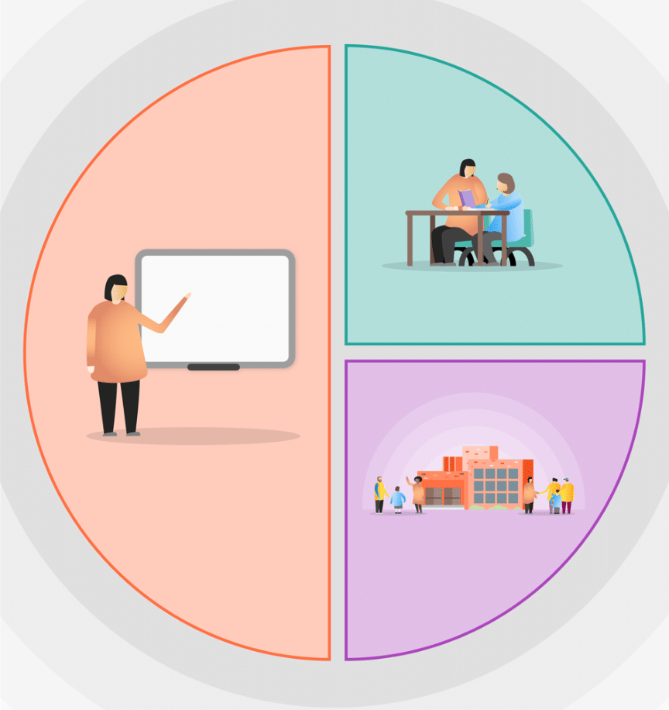
A Tiered Approach to Pupil Premium
Quality First Inclusive Teaching
Targeted Academic Support
Wider Strategies
Notes:
Government strategy for schools is to divide funds into 3 sections. Majority of funding should be to improve teaching and learning in the classroom, then to provide support to improve children’s progress and attainment/outcomes, then any other areas that may need to support.

Slide 4

A Tiered Approach to Pupil Premium
1. Teaching
Quality First Inclusive Teaching
Ensuring good and outstanding teaching is the most important thing schools can do to improve outcomes for pupils. Using the Pupil Premium Grant to improve teaching quality benefits all pupils and has a particularly positive effect on children eligible for Pupil Premium. Our priority is to ensure that a highly effective teacher is in front of every class, and that every teacher is supported to keep improving.
Targeted Academic Support
Wider Strategies
Notes:
Government advice is to make this the main area of spending. Excellent teaching will improve pupil outcomes.

Slide 5
A Tiered Approach to Pupil Premium
1. Teaching
Providing continual training in all areas of the curriculum but particularly English and Maths so that all pupils are able to access high quality learning.
Support curriculum planning to ensure gaps are identified and new material builds on secure foundations.
Class teacher to provide ‘pupil conferences’ and targeted support.
Quality First Inclusive Teaching
Targeted Academic Support
Wider Strategies
Notes:
What we do at PJS…

Slide 6
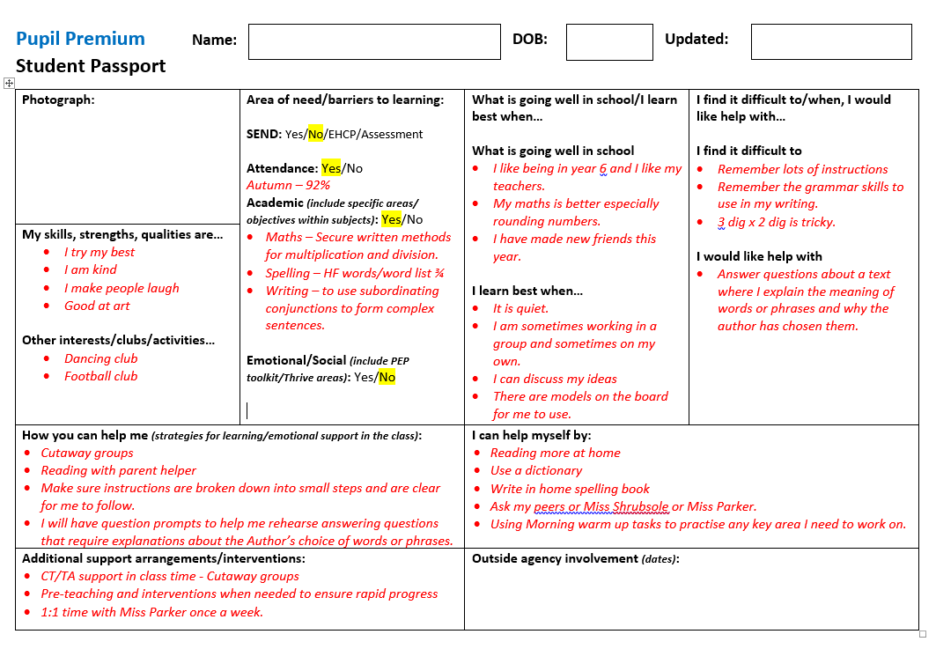
What is looks like at PJS…
Attendance
Emotional well-being
Passport
We consider all aspects of a child’s learning to create a passport with the child which outlines the child’s and teacher’s view of their key needs and how best to support them.
Progress & Attainment
Passport
Notes:
The passport focuses teachers and children on how they learn best and areas where more support is needed.

Slide 7
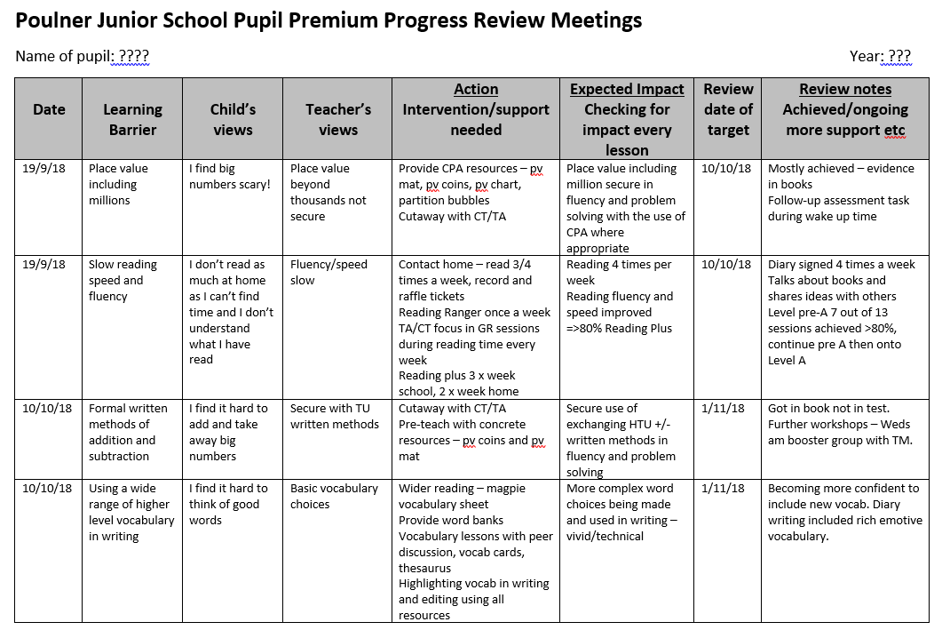
What is looks like at PJS…
Pupil studies & moderation
Conference & observation
Marking & Feedback
Tracker
Data & Assessment
Trackers
The information gathered on the passport is considered alongside knowledge of how the child is learning in the classroom. Next steps/targets are identified on a personalised tracker.
Notes:
The trackers have small steps that are achievable in 3 weeks so that it builds success for the child. Consider next steps for the child to ensure progress.

Slide 8

What is looks like at PJS…
Conference
The class teacher will spend time 1:1 with your child every few weeks. This time is spent reviewing the tracker targets and how the teacher can further support your child’s learning. It is also a time for the child to reflect on their learning and progress – how they learn best and how they can use these strategies to help them learn better in other areas.
Notes:
Conferences allow for pupil voice.

Slide 9

A Tiered Approach to Pupil Premium
2. Targeted Academic Support
Evidence consistently shows the positive impact that targeted academic support can have, including on those who are not making good progress across the spectrum of achievement. We consider how classroom teachers and teaching assistants can provide targeted academic support, including how to link structured one-to-one or small group intervention to classroom teaching.
Quality First Inclusive Teaching
Targeted Academic Support
Wider Strategies
Notes:
Provides support to improve academic progress and outcomes.

Slide 10
A Tiered Approach to Pupil Premium
2. Targeted Academic Support
Providing high-quality group tuition during school by the class teacher to ‘bridge the gap’.
Teaching Assistants providing one to one and small group targeted support
Specific catch up planning for pupils.
Quality First Inclusive Teaching
Targeted Academic Support
Wider Strategies
Notes:
Teachers provide focus teaching in small groups after identifying gaps in learning. Work in collaboration with TA to provide support.

Slide 11
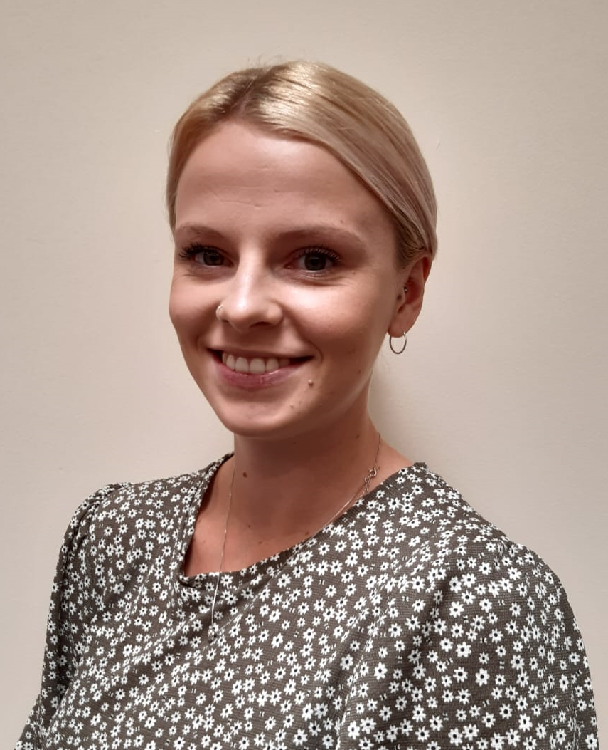
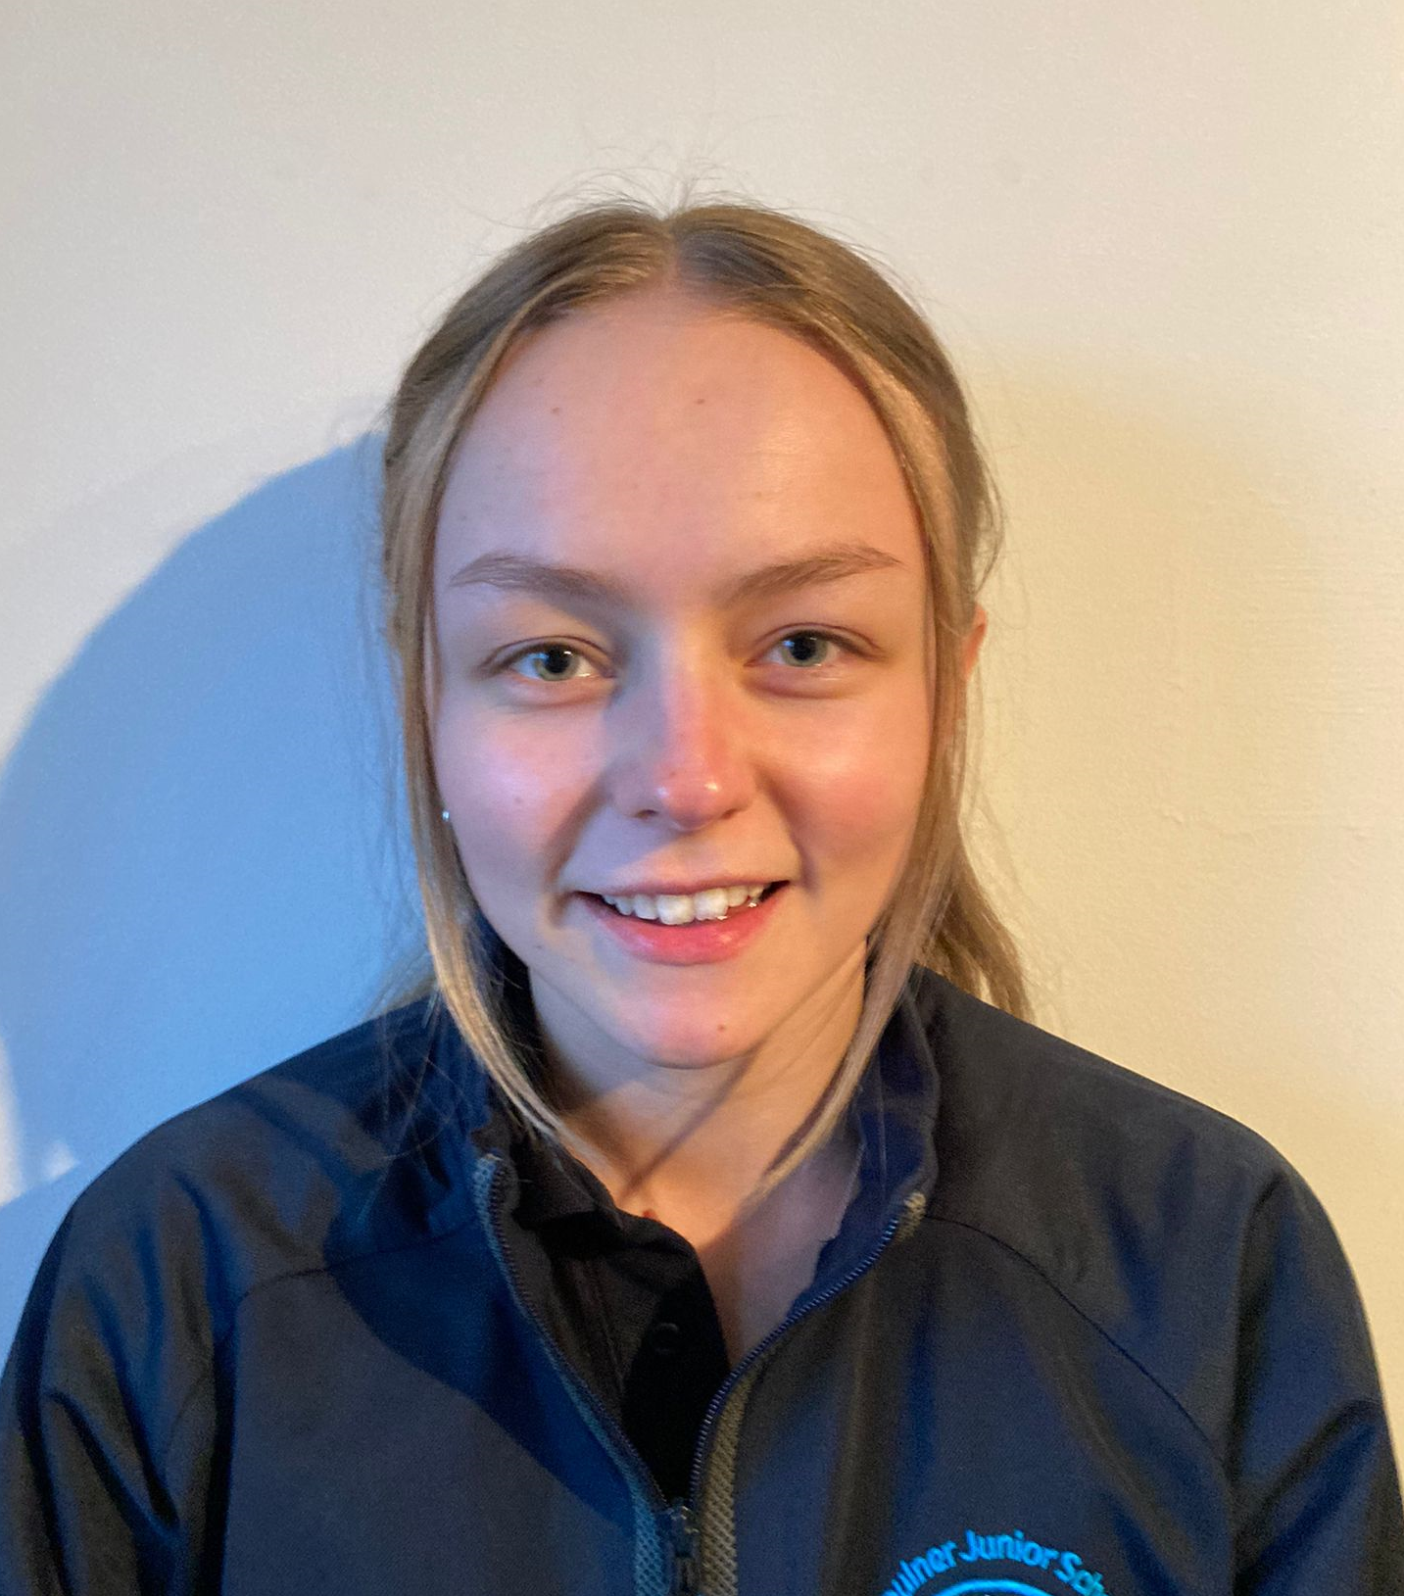
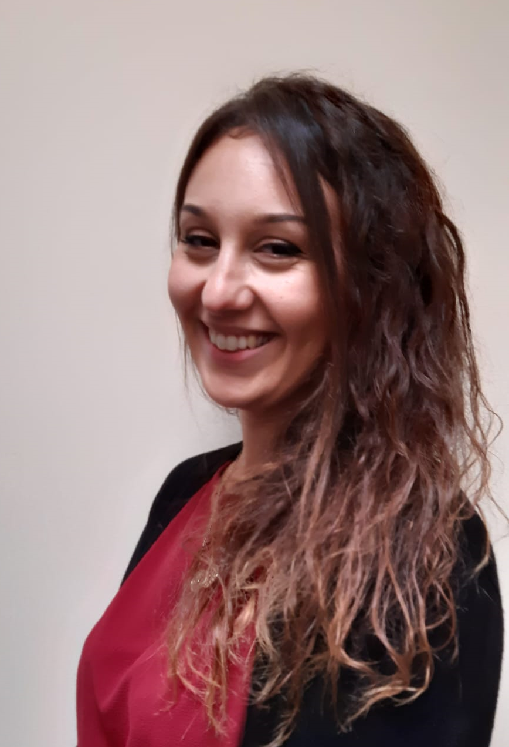
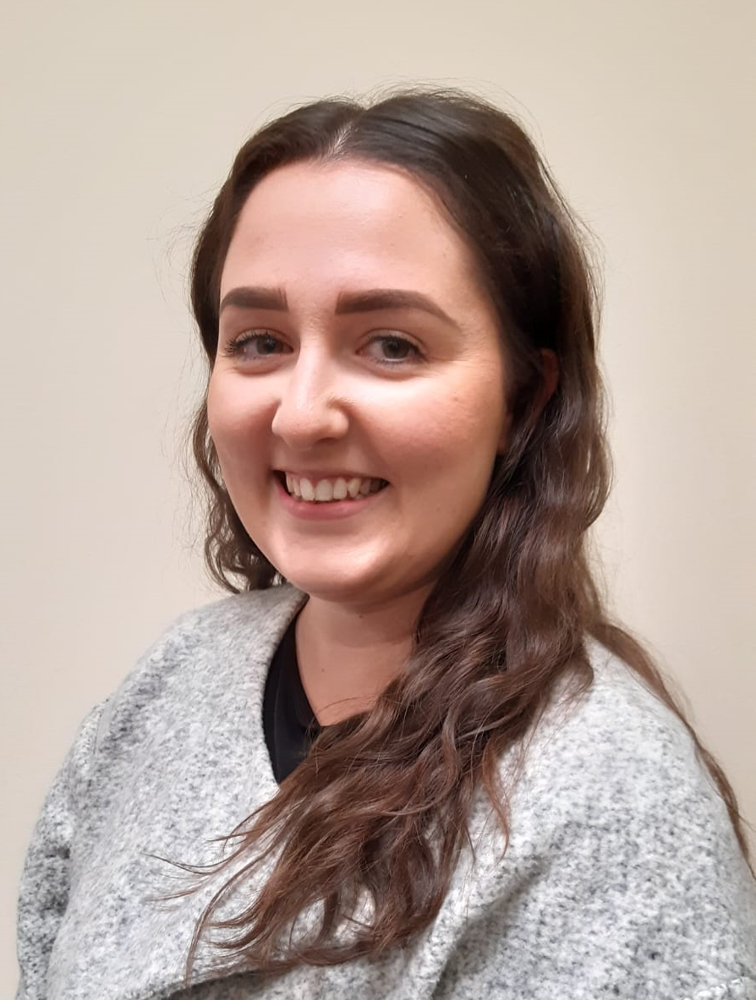

What is looks like at PJS…
Pupil Premium Champions
Alongside the class teacher and teaching assistant, the pupil premium champions work with the children to help them achieve success with their targets. They liaise closely with the class teacher to plan interventions that support the learning they are doing in class and close any gaps.
Year 3
Year 5
Year 4
Year 6
Notes:
Government have provided additional funding for children to catch-up. We have 4 ‘pupil Premium champions. – 1 for each year group. Provide support in extra tuition/interventions in and out of school.

Slide 12
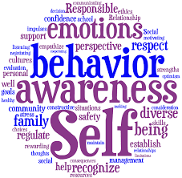
A Tiered Approach to Pupil Premium
Quality First Inclusive Teaching
Targeted Academic Support
3. Wider Strategies
Wider Strategies
We aim to focus on the most significant needs, including attendance, behaviour and social/emotional support.
Notes:
Social/emotional support is the biggest area of extra need currently.

Slide 13
A Tiered Approach to Pupil Premium
Quality First Inclusive Teaching
Targeted Academic Support
3. Wider Strategies
Wider Strategies
ELSA and Thrive small group and one to one nurture time to support children emotionally and socially.
Providing continual ‘Thrive’ training to assess the needs and provide intervention for those children needing emotional and social support.
Notes:
Thrive approach is based on attachment and behaviour psychology.
Restorative approach to behaviour – recognising and improving behaviour not just punishing.

Slide 14
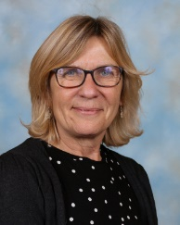
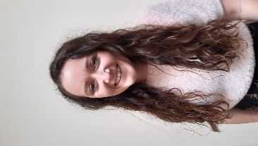

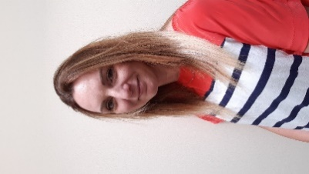

What is looks like at PJS…
Our Thrive Team
Mrs Smalley
Our Thrive team dedicates time to children 1:1 or in small to groups to support their social and emotional needs.
Mrs Johnson
Mrs Page

Slide 15

MYTH: “The Pupil Premium has to be spent on interventions”
There is a strong evidence base showing the impact that high quality interventions can have on the outcomes of struggling students. However, while interventions may well be one part of an effective Pupil Premium strategy, they are likely to be most effective when deployed alongside efforts to improve teaching, and attend to wider barriers to learning, such as attendance and behaviour.
MYTH: “Only eligible children can benefit from Pupil Premium spending”
The Pupil Premium is designed to support schools to raise the attainment of disadvantaged children. However, many of the most effective ways to do this – including improving the quality of teaching – will also benefit other groups: that is fine. Likewise, some forms of targeted academic support or wider strategies will benefit other children, including children with Special Educational Needs and Children in Need.

Slide 16

Providing targeted academic support for pupils who are not making the expected progress.
Ensuring 'outstanding' teaching in every class.
Our Priorities
Closing the attainment gap between pupils and their peers.
Addressing non-academic barriers to attainment such as attendance and social and emotional needs.
Ensuring that the PPG reaches the pupils who need it most.

