Slide 1

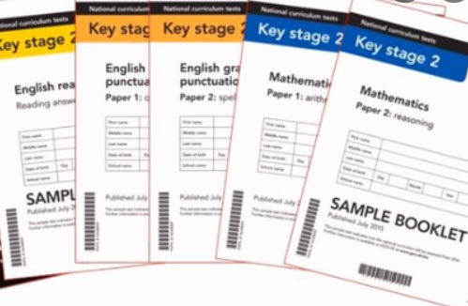

Year 6 SATs Information Evening
Monday 12th January 2026
There will be an opportunity for questions at the end of our short presentation.
Copies of the slides will be on our website under the year 6 page ☺

Slide 2

SATs – What's it all about & who is it for?
It is a measure- it measures the school and it measures the child.
The benefits for the school:
It will help future parents decide where to send their child.
It is an indicator of the improvements and quality of learning that the school provides it’s pupils.

Slide 3



SATs – What's it all about & who is it for?
The benefits for the child:
When they leave primary education, with secure foundations, they can access secondary school much more successfully.
They have started to learn some self study techniques (essential for Secondary school!!) and the mind-set that applying themselves will make a positive difference.
Increased confidence – they have tried their best, reached their potential and therefore more positive about the future.
A sense of pride that they have sat these tests and approached them brilliantly!
A sense of community & teamwork – We are all in this together!

Slide 4
SATs – Boosters
Boosters:
A letter will be sent out shortly - these groups are invite only as they are smaller and more bespoke to what your child needs.
Some children will not be invited as they will have needs met enough through classroom teaching or additional workshops and catch ups that already run in the school day.
These groups may change after Mocks depending on outcomes.
These sessions run after school 3.20-4.20pm and do include a drink and biscuit(s)!
Each session is led by an experienced teacher who has a specialism in that subject area.
The benefits are to support children to close gaps in any missing knowledge and understanding. It ensures that they are leaving year 6 with a more secure basis for the start of Year 7 and greater confidence.
Please encourage and support these boosters if your child is invited to one or several of these sessions.

Slide 5
Additional Support
SATs does allow and encourage some children to access additional support during the tests, as the aim is to give children the opportunity to show what they understand.
2 levels of support:
School led adaptations- we can provide children with prompters, a smaller quieter space, a brain break if needed.
Applied for adaptations- we will be in contact with you to confirm whether we will be applying for additional support. This may be the use of a scribe, an adult support reader or additional time.
There are strict criteria for these additional supports and we will be working with you and your child to gather appropriate evidence if we feel that this is appropriate.

Slide 6
Revision guides & workbooks
These are important and cover all key areas that will be assessed during the SATs tests.
It is important that the workbooks are completed each week. This means that children will have covered all aspects and they will be able to use this to refer to and recap, instead of worrying that they have not completed everything.
These books are being used in class and through the home learning set so they will be completed before SATs.
If your child is unsure of any aspects then please let the teacher know, we would rather go over and secure learning with them than leave it unanswered.
Please do encourage your child to read the guides and use these to complete the learning each week.

Slide 7




SATs – The testing week timetable
Monday 12th May 2025 – Thursday 15th May 2025
All tests will take place in the morning.
Date | Test | Time
Monday 11th May | English grammar, punctuation (SPAG) Paper Spelling | 45 mins No time limit but Approx 15 mins
Tuesday 12th May | English Reading | 1 hour
Wednesday 13th May | Maths Arithmetic Maths Reasoning | 30 mins 40 mins
Thursday 14th May | Maths Reasoning | 40 mins
Friday = Rest & PARTAAAYYYY!

Slide 8
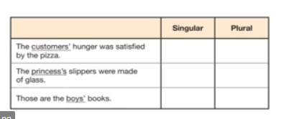
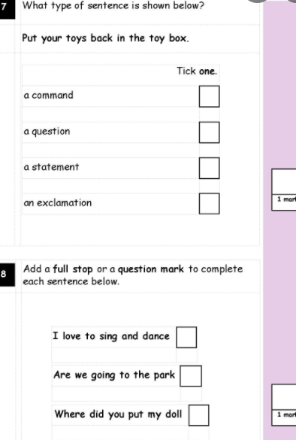
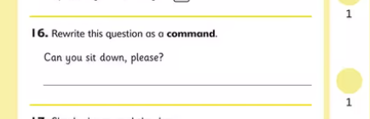
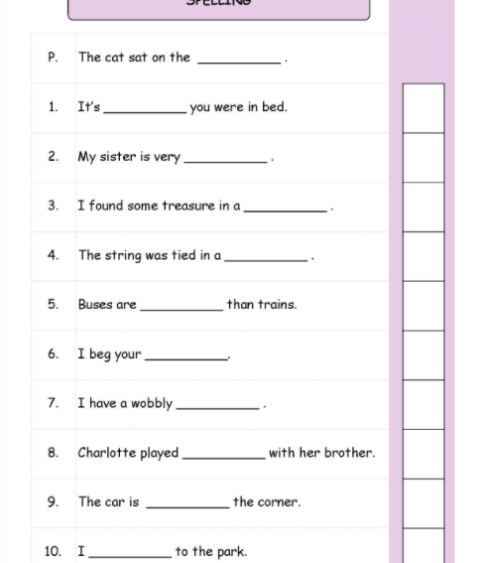
SATs – The Papers…
English Punctuation & Grammar: Total Marks = 50.
It will include two types of questions:
Selected response/multi-choice style questions. e.g. ‘Identify the adjectives in the sentence below’
Written response style questions, e.g.‘Correct/complete/rewrite the sentence below,’ or, ‘The sentence below has an apostrophe missing. Explain why it needs an apostrophe.
**Children will be penalised for incorrect use of punctuation and spelling**
English Spelling: Total Marks = 20.
This test consists of 20 words with 20 possible marks.

Slide 9
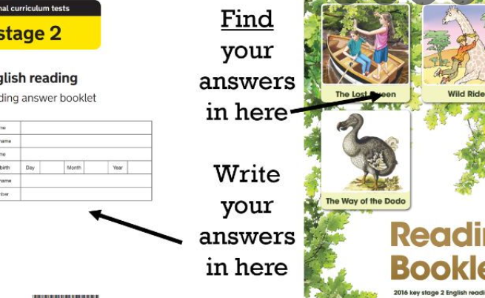
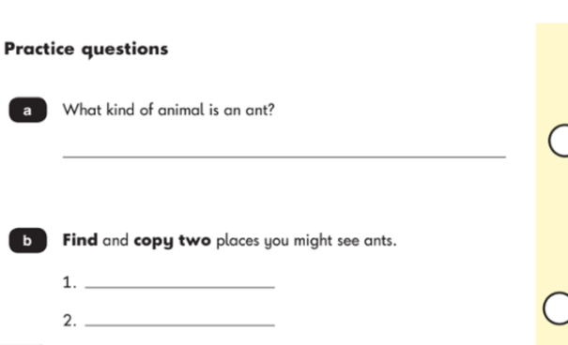
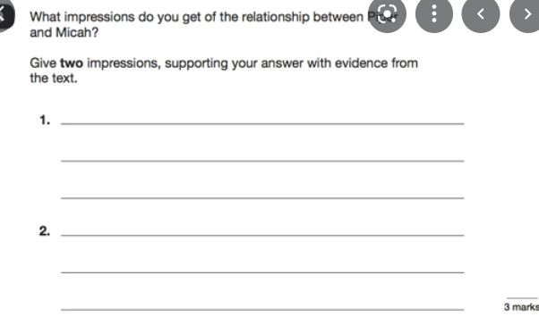
SATs – The Papers…
English Reading: Total Marks = 50.
This test includes a reading booklet with 3 different texts (increasing in difficulty) and questions based on each test.
Question examples include:
Ranking/ordering, e.g. ‘Number the events below to show the order in which they happen in the story’
Labelling, e.g. ‘Label the text to show the title of the story’
Find and copy, e.g. ‘Find and copy one word that suggests what the weather is like in the story’
Short constructed response, e.g. ‘What does the bear eat?’
Open-ended response, e.g. ‘Look at the sentence that begins Once upon a time. How does the writer increase the tension throughout this paragraph? Explain fully, referring to the text in your answer

Slide 10
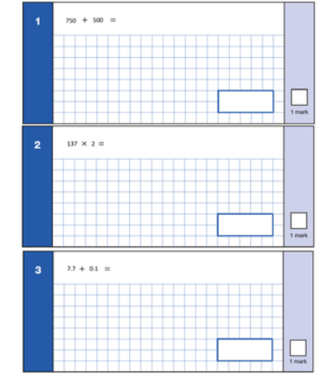
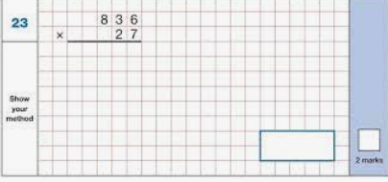
SATs – The Papers…
Maths Arithmetic: Total Marks = 40.
This test comprises of 36 Questions.
Questions will cover the following topics:
Addition
Subtraction
Short and long multiplication
Short and long division
Finding percentages of quantities
Adding, subtracting, multiplying and dividing Fractions
Adding, subtracting, multiplying and dividing decimals

Slide 11
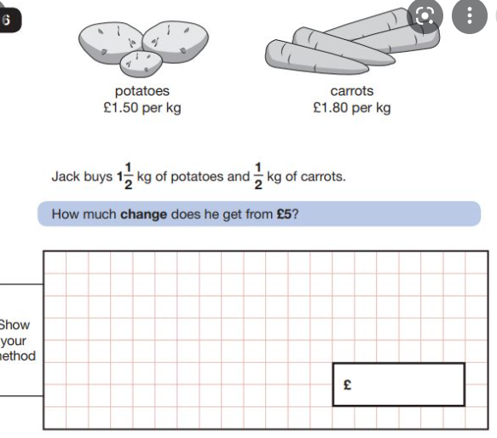
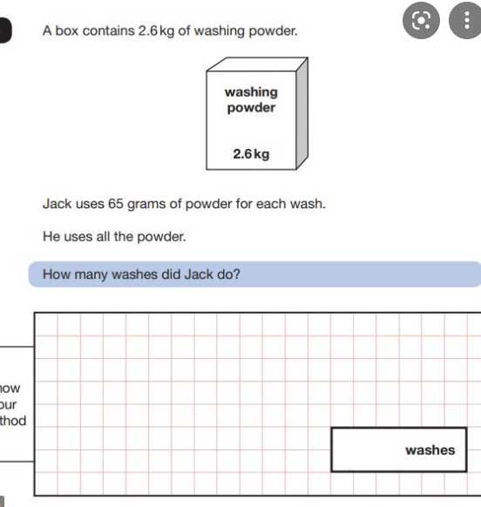
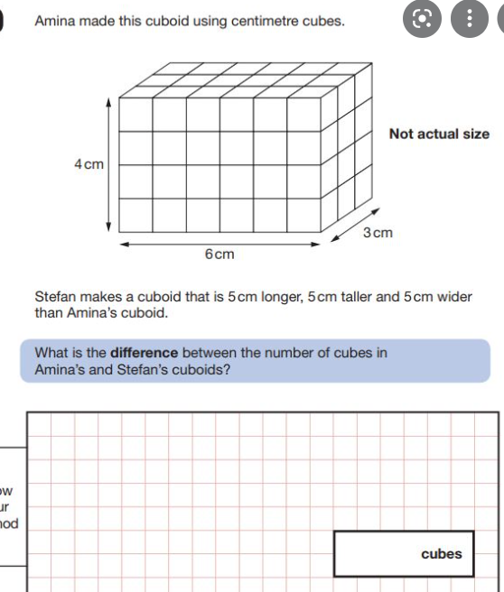
SATs – The Papers…
Maths Reasoning: Total Marks = 35.
These tests have 26 questions.
Questions will cover all aspects of maths including:
Measure – weight, volume, time, no. of days in month!!
Geometry - shape & angles
Geometry – position & direction
Four operations
Fractions. decimals, percentages
There will be a range of question types, including simple, single step calculations and more complex problem solving.
Where more complex problems arise, children will be awarded marks for showing their working.

Slide 12


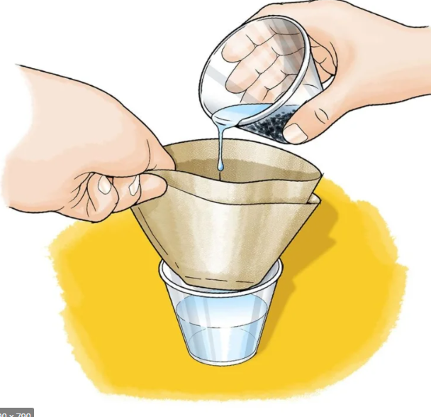

SATs – The timeline
Mock SATS:
Next round: w/c Monday 26th January
Final round: w/c Monday 23rd March
You’re welcome to do some light revision but please do not use any SATs papers from the internet.
Test papers are analysed and lessons adapted accordingly.
Booster groups may be adjusted.
Our curriculum will remain broad and balanced - rest and release is just as important as hard work!!

Slide 13

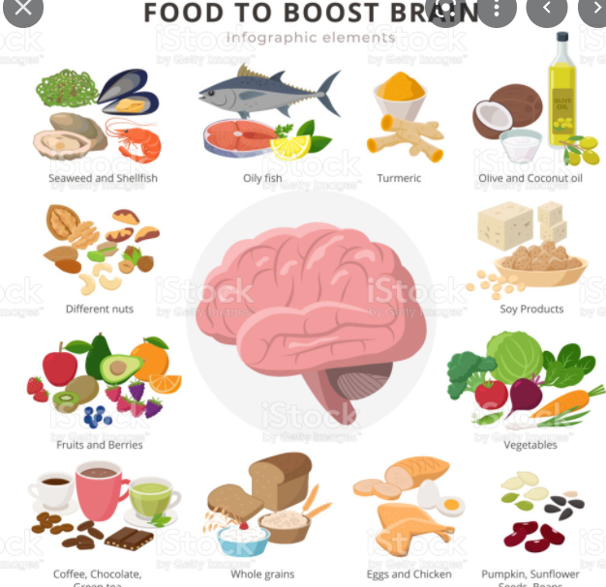

SATs – The build up and the week of the tests
Your child is bound to feel nervous – this is okay!!
We will do all that we can to make them feel reassured and supported - it is important that you bring them in.
Snacks and a water bottle are key – brain fuel!
We provide all stationery but if your child has a particular pen/pencil that they prefer to write with then they can use it for the tests.
A good meal each night – refuel ready for the next day!
We will provide a breakfast club on the testing days, which will be in the Year 6 rooms, from 8am (this is free to the children). It is a chance to come in early, settle the nerves and to realise it is all okay!

Slide 14



SATs – Supporting your child
Praise the effort not the outcome!
Booster sessions now run on Mondays, Tuesdays, Wednesday and Thursdays.
Revision books- pages set weekly on a Thursday, ready for the following Tuesday.
Come and ask/ speak to us!
Little and often practise – 15 mins every day will make a HUGE difference.
Daily essentials:
  Talk, talk and talk about feelings – reassure & support.
  Reading and responding to questions
  Timetables practise
  Spelling Practise
  SLEEP & relax – DO NOT OVERLOAD!

