Slide 1

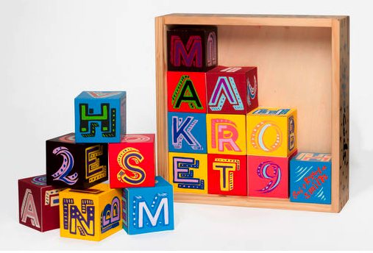
Wellbeing in the 21st century
It’s not like when we were kids!

Slide 2
Welcome
Our Aims for the evening
Raise your awareness of the current climate for children
Support your understanding of mental health and children’s wellbeing
National and local picture of online crime and exploitation
Gain a perspective of children’s current online activity/social media use
Be prepared for what lies ahead and how you can arm yourselves and them
Notes:
Welcome guests, Barbara, Abi, Mary, PCSO Alex Baldwin, Claire Adams DHT DSL at Ringwood

Slide 3
The current climate
Let’s start with the hard truths…
The childhood that children have today is not the childhood that we or our elders experienced.
Children are exposed to far more information from a wider range of sources than ever before.
The threats to our children’s safety are greater through screen than we ever experienced through potential ‘stranger danger’.
The pressures of modern day life have shown a marked increase in the numbers of children with mental health issues and concerns from low level through to extreme cases.
Children are smarter and more intuitive with technology than we are- they are one step ahead of their parents.
Notes:
One of the hardest elements as a parent is that we often gain our parenting skills from our parents, but we don’t have that luxury when it comes to this.

Slide 4
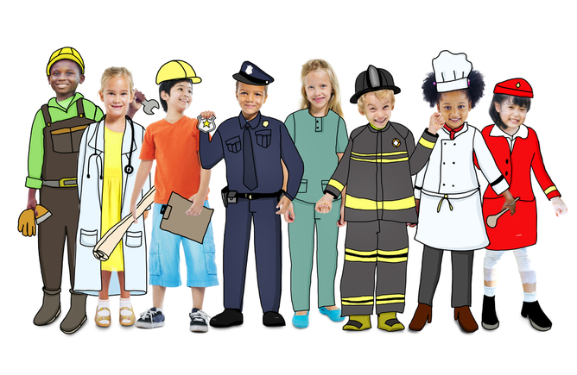
So what are the benefits of growing up in today’s society?
Notes:
Not just doom and gloom- the answer is not to ban it all- group activity- what are the benefits of social media and the internet/Www? Gather ideas & share on whiteboard

Slide 5
Benefits & dangers
The Internet is a powerful force for good. It serves humanity, spreads ideas and enhances freedom and opportunity across the world. Combined with new technologies, such as artificial intelligence (AI), it is set to change society perhaps more than any previous technological revolution – connecting people, making us more productive, and raising living standards.
However, alongside these new opportunities come new challenges and risks.
Green Paper 2018
Every aspect of society is concerned though about the risks and challenges.

Slide 6
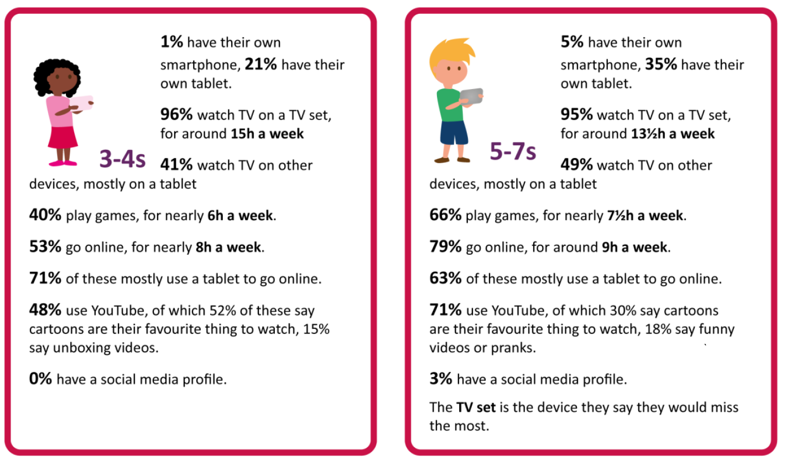
Let’s talk ofcom statistics…
Notes:
So what is the current climate- on average how much are children accessing IT and at what age?

Slide 7
Let’s talk ofcom statistics…
Notes:
Surprising??? Shocking? So what does the older ages look like?

Slide 8
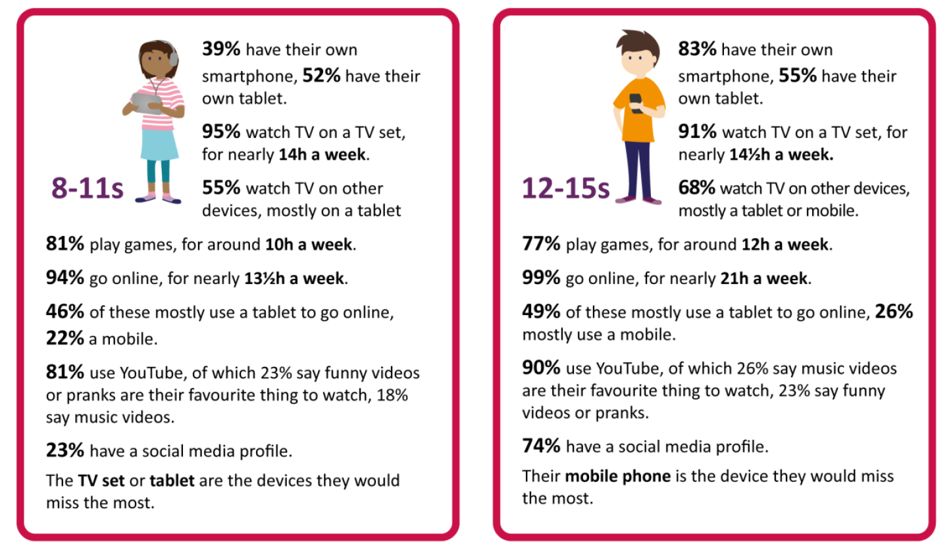
Let’s talk ofcom statistics…

Slide 9
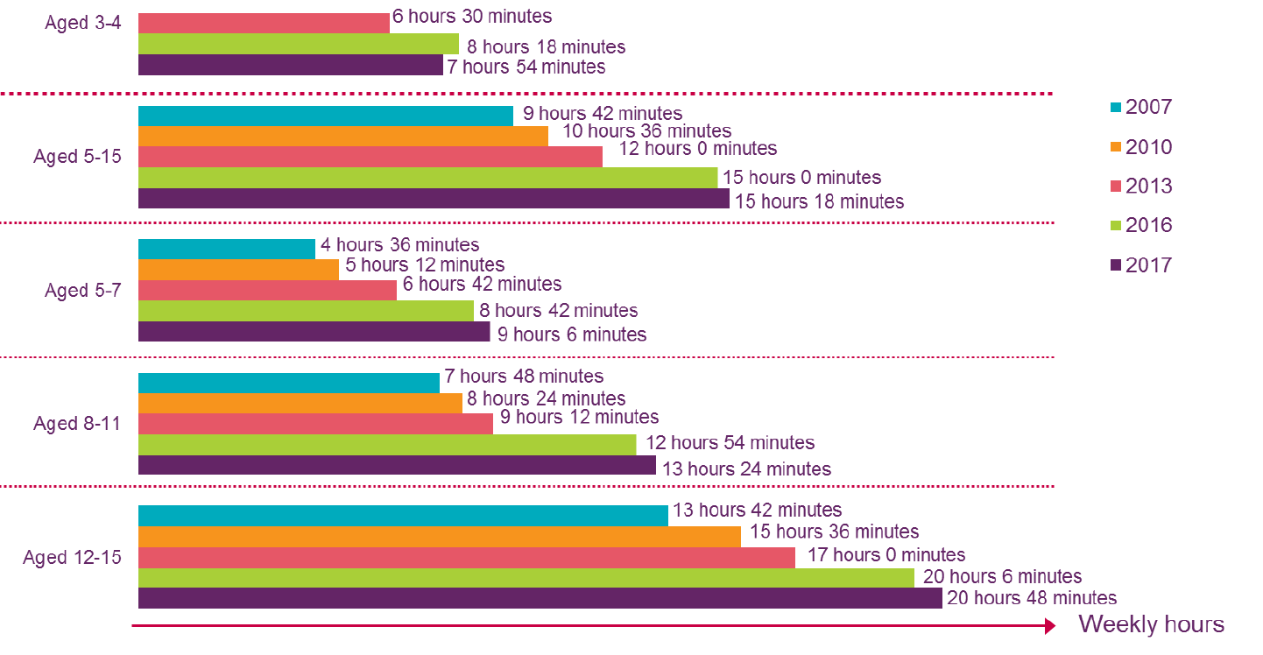
How times are changing
Notes:
Gaming time per week

Slide 10
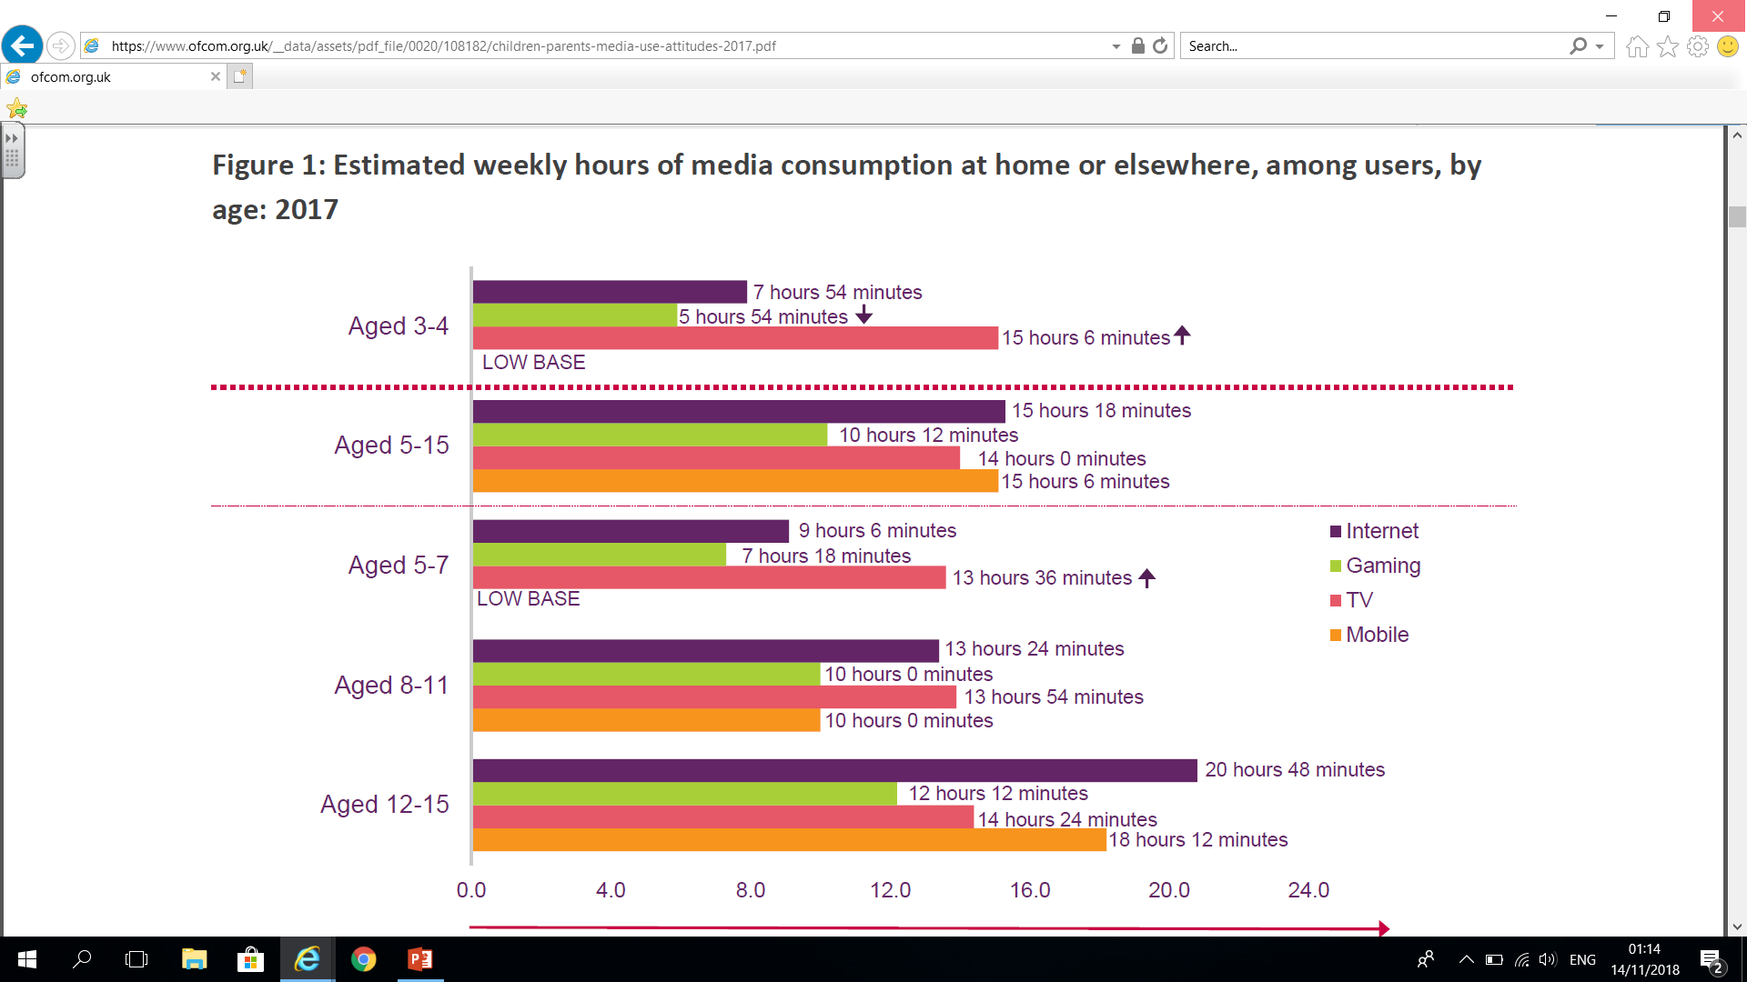
Online time

Slide 11
The current climate
‘It is clear that, while the evidence around the impact of social media and internet use is not yet conclusive, there are potential negative impacts. These include, but are not limited to:
Social isolation
Competitive pressures
Increased vulnerability
Increased exposure to abusive content
Increased likelihood of cyberbullying
Increased risk of grooming for exploitation.’
Government response to the Internet Safety Strategy Green Paper, May 2018
Notes:
I don’t believe that any parent would openly allow their child to be at an increased risk to any of these, but looking at the statistics- we do!

Slide 12
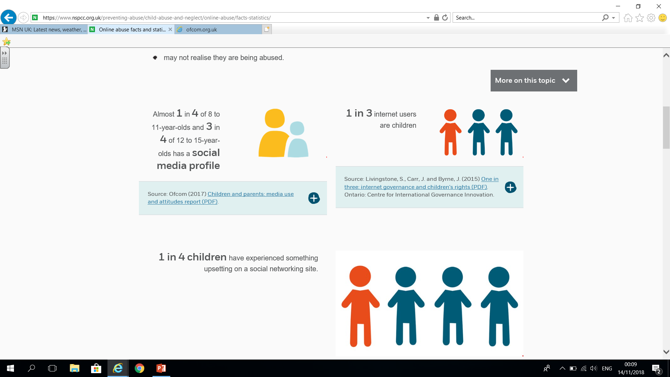
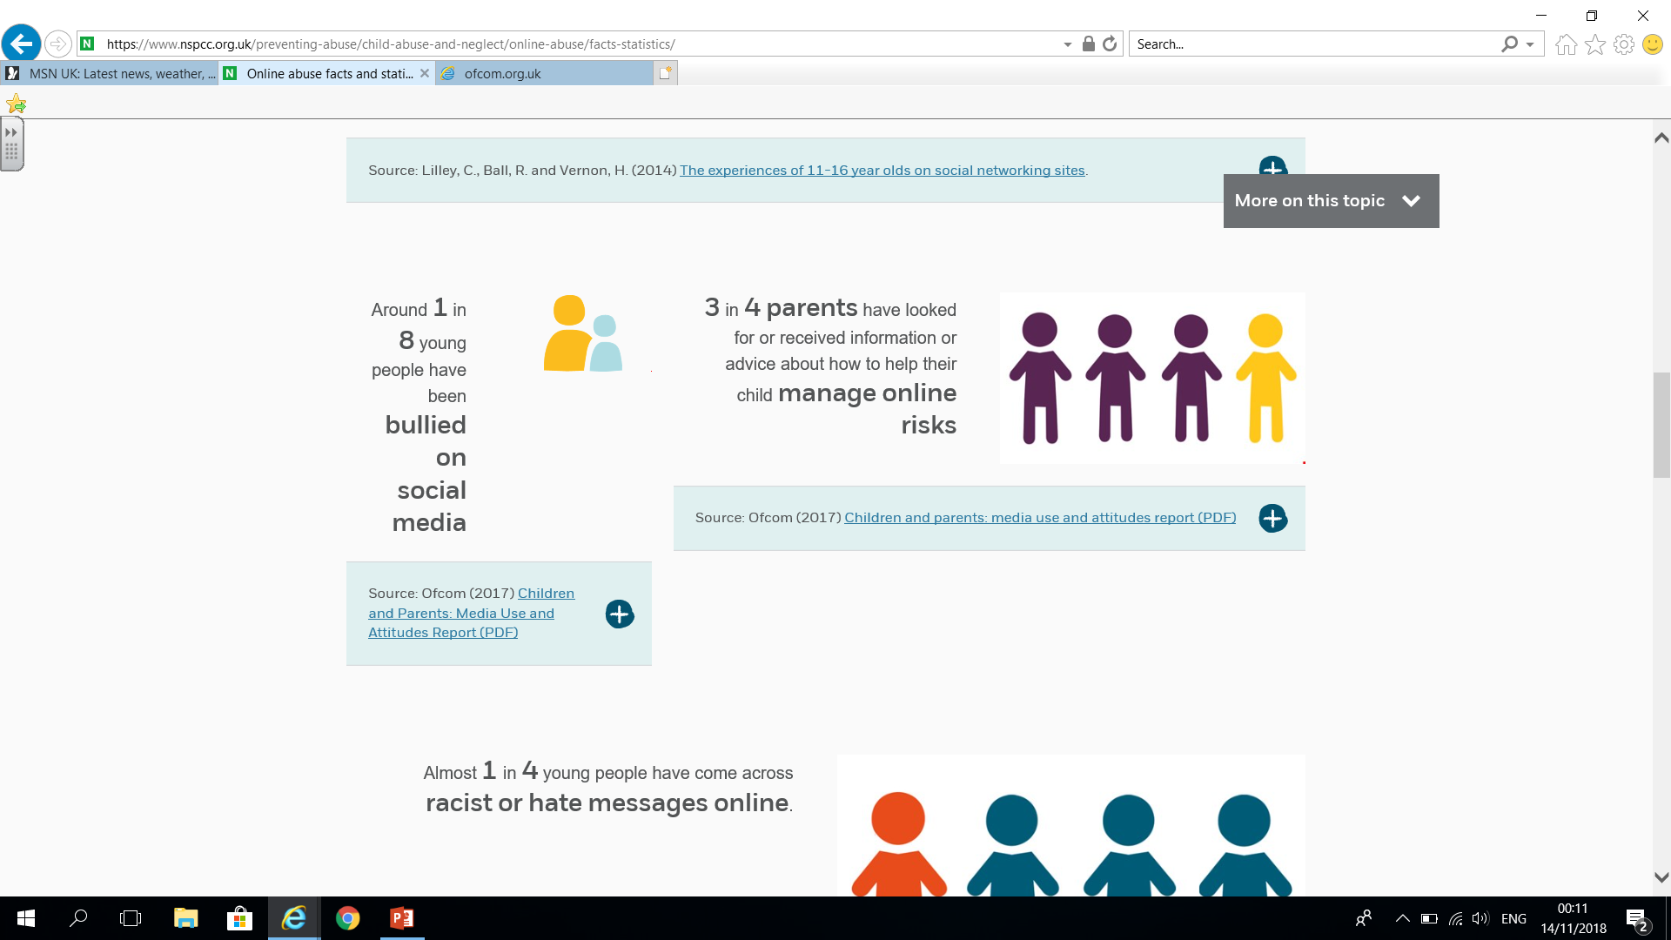
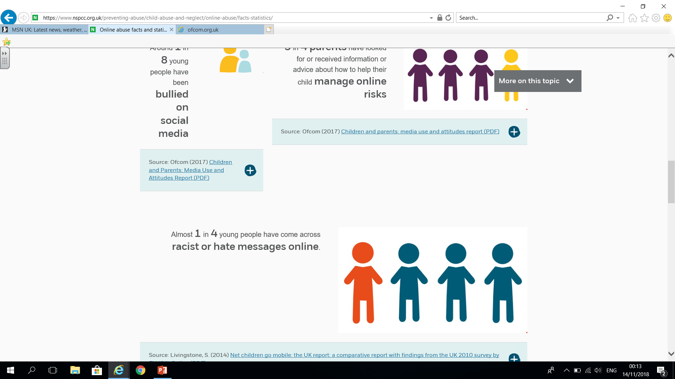
NSPCC statistics

Slide 13
What Do we see in school?
Online bullying and friendship issues that get out of hand
Children’s play and creativity is hampered and effected by what they are accessing from social media and Youtube. Limited vocabulary and social skills
Children’s interests and activity levels are reduced and their free time is obsessed with online chatrooms and gaming
Parents are not sure what their children are doing and are worried about introducing restrictions and are instead accepting that ‘everyone else is doing it, so it’s ok.’
Notes:
So that was some of the statistics- but this is the reality of what we see day in, day out.

Slide 14
Cyberbullying- whose responsibility?
Sources
In school fall out
Online fall out linked to chat groups
Derogatory comments linked to online gaming groups
Use it as tool to upset others, with no physical presence
What to do?
Let school know- we can help with mediation, although if it began online then it is not our responsibility to sort out the problem, but we recognise that we can help the child/ children to resolve conflicts.
If you know the other child’s parents then you may feel it appropriate to contact them and resolve together.
Screen shot/record evidence/abuse if possible
Remove the technology from your child and talk to them about what has happened and reassure them.
Increase parental checking and monitoring
Seek out positive face to face friendship opportunities e.g. a friend for tea/play without technology

Slide 15
One of our biggest worries- anxiety
Child’s anxiety | Parent anxiety
All my friends are online and I am missing out if I am not on it too | My child will feel left out from their friends, I want them to be happy and included
Gaming- I need to get past this level, if I don’t play everyday then I won’t get my points/ bonus rewards | I want my child to have the latest gaming and technology, I work long hours and I want to treat my child
I need to have instant response and feedback | I worry about their reaction and behaviour if I take the technology away from them or limit them
I feel more comfortable talking to people online and I prefer to stay in to communicate with my friends and gain experiences | They behave better when we are out if I let them take their tablet/phone with them
I have loads of ‘friends’ and followers online and it’s more than the friends I have in school | I don’t know who my child has made ‘friends’ with online and I don’t know how much information they know about my child or about my family/location
Notes:
We are seeing anxieties from both parents and children

Slide 16
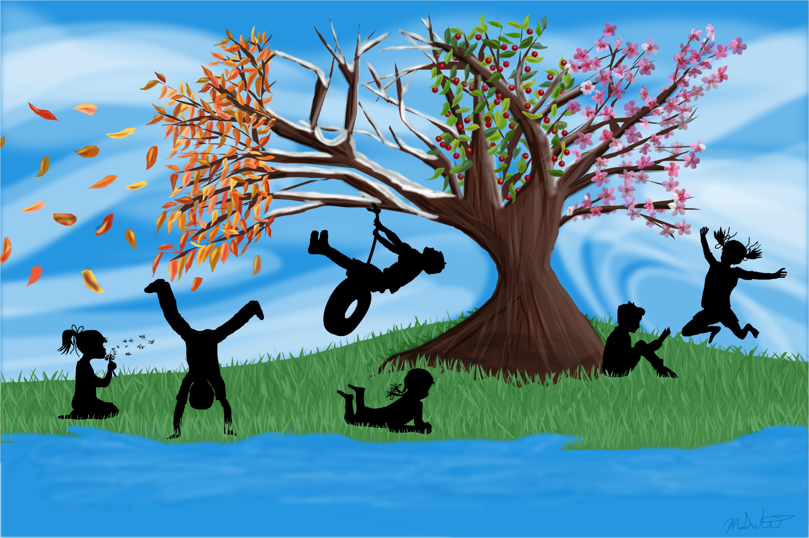
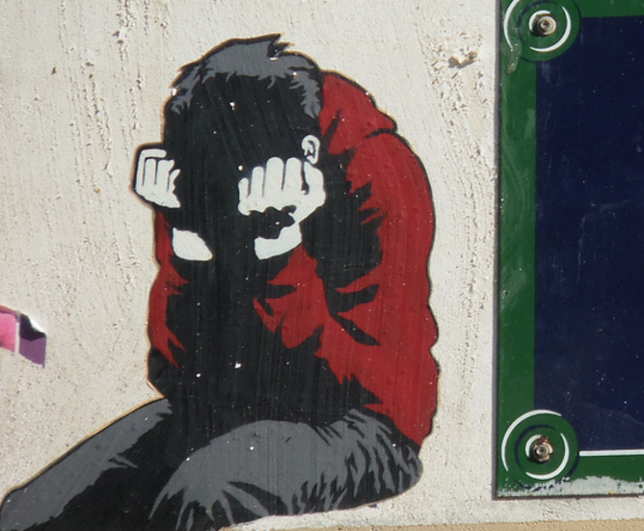
Mental health
& wellbeing
Childhood should be the happiest time in a person’s life, yet for thousands of children who develop mental illness in childhood or adolescence, the reality can be very different. One in ten (around 850,000) children and young people have a diagnosable mental health condition.
These illnesses can have a devastating impact on their physical health, their relationships and their future prospects. The challenge often extends into a person’s adult life, with half of all mental health conditions beginning before the age of 14.

Slide 17

Barbara Johnson & abbie page

Slide 18
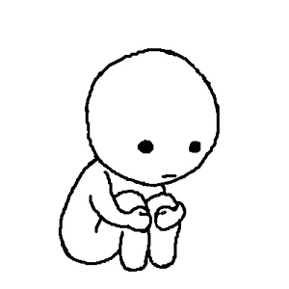
What we see and how we support mental health & anxiety
Anxiety- low self esteem, attendance slipping, tearful, children not sleeping, change in personality, children not themselves, giving up, lesson refusal, refusals at home, primitive social skills, not eating, controlling behaviours, angry outbursts
But aren’t all of these due
to their hormones?

Slide 19
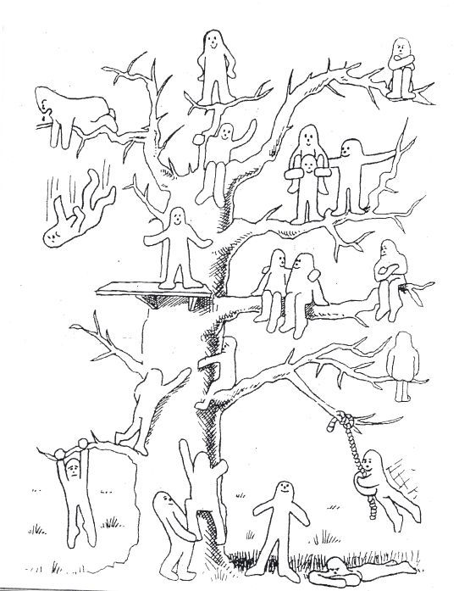
What we see and how we support mental health & anxiety
How do children come to our attention?
Parent concerns
Family changes- separation, move of house, bereavement,
siblings, illness, domestic abuse, parent mental health,
Behaviour changes noted by an adult
Learning barriers which lead into emotional turmoil/trauma
Teacher referral system
The support we offer?
Joined up approach
Approachable & non-judgemental
Breakfast and lunch club
Wake n Shake
ELSA- 1:1 and group sessions
Check lists for children and parents
PSHE Jigsaw curriculum
Relax Kids Club
Accessible support for parents as well as the children
Liaison with ‘We listen Counselling’
Sign post to local community and National bodies for support
Liaison with Children’s Services and other agencies when required

Slide 20
Advice for parents
Listen to your child- don’t dismiss what their concerns are
Let your child know that they can always talk to you
Remember that your child is unique so help them not to compare
Recognise the negatives of a situation/event, but balance out with some positives
1:1 time (even 5-10 mins) is just so important
If you have a concern it is there for a reason
Let your child know that it’s ok to have a bad day/week
Don’t be afraid to ask for help- school or GP
Don’t tell your child everything- they don’t need to know and don’t have the capacity to process adult information and issues
If your family is separated don’t dis-respect the other parent, even though you may be tempted!
If you definitely know a change will happen let the school know and also think carefully about how this will be shared with the child.
Fresh air, exercise and laughter together can make any situation feel a bit better!

Slide 21


Pcso Alex Baldwin

Slide 22
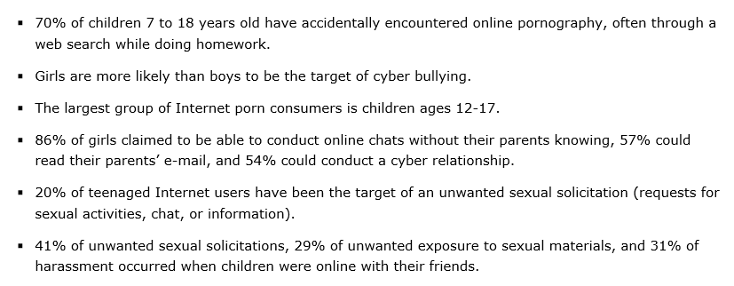
National statistics

Slide 23
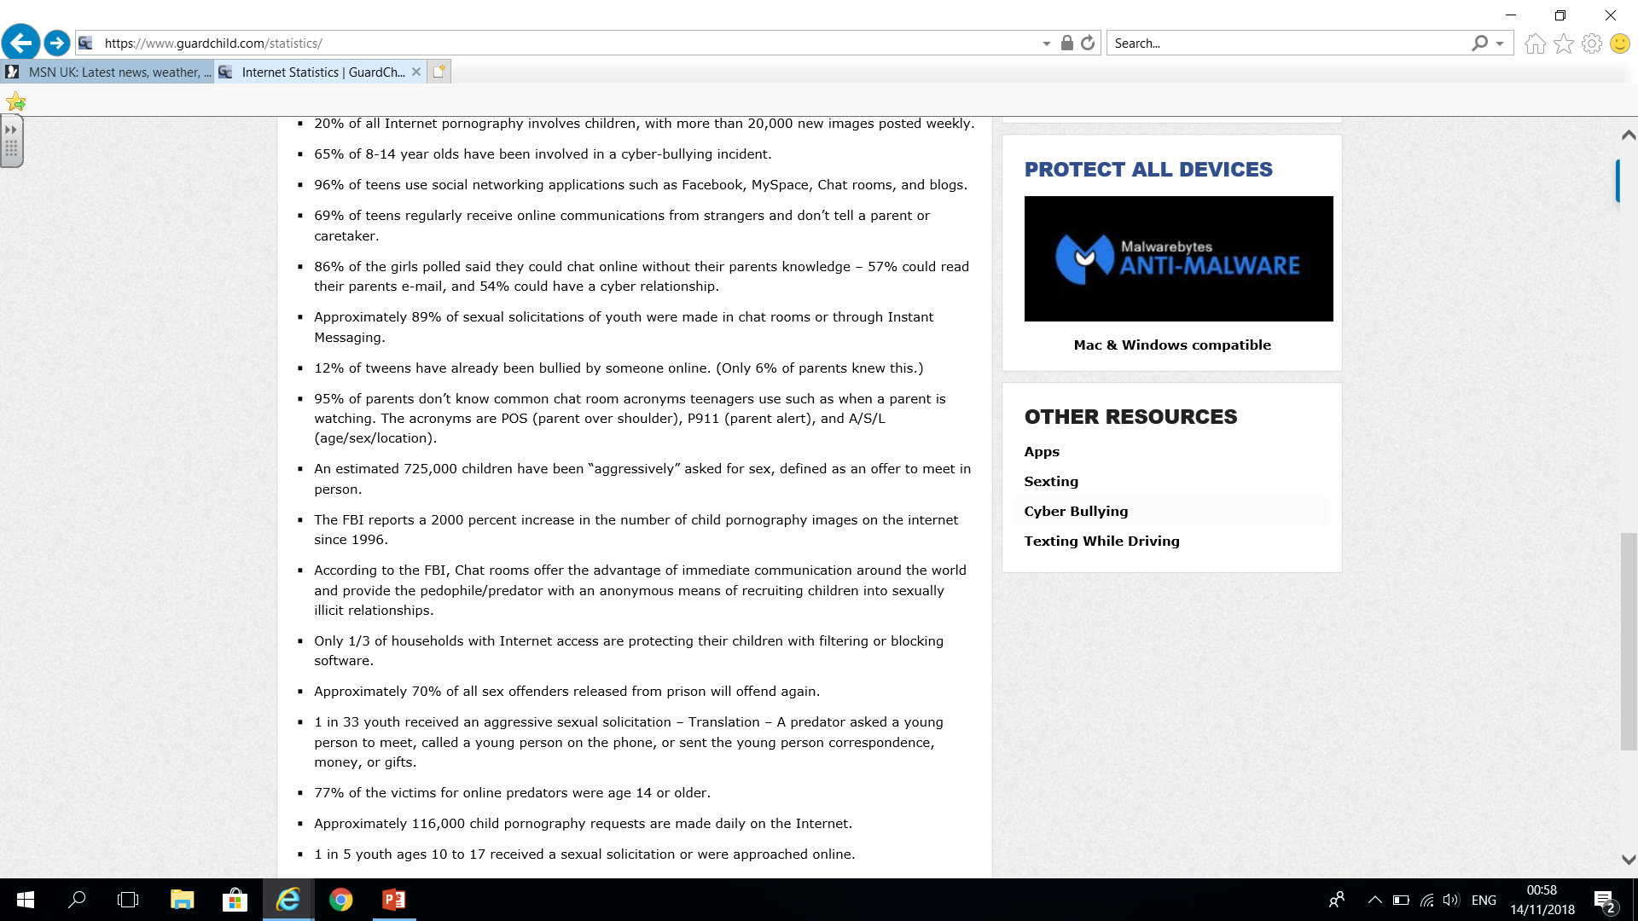
National statistics

Slide 24
National statistics

Slide 25
Personal accounts
It does happen in Ringwood and Hampshire and it has happened to Poulner children and their families.

Slide 26
Advice for parents
Talk to your children about the sites they are using and who they are linked in with.
Do your own research into icons on their technology and what age restrictions are set to these and why.
Set clear boundaries together and be open about the need for you to be able to check what they are doing and writing.
Set guidelines about chatrooms and the need to personally know the ‘friends’ they link in.
Children’s phones and IT devices stored out of the their bedroom.
Let your child know that they can tell you anything, and that if they feel scared or worried that they absolutely can tell you- no judgements.
Help them to understand that once its been written or shared it is out there permanently.
Friends and followers to your child’s profile could be anyone, any age, any intention- it’s not a popularity contest- agree on real friends only.

Slide 27
Our school findings
We asked Poulner children some of the following questions…
Have you ever accepted a friend request from someone you do not know?
Has anyone ever been mean or unkind to you on-line?
Do you ever see things that make you feel uncomfortable?
Notes:
What do you think they said? Higher or lower than national published figures?

Slide 28
Percentage of students on-line
& what they are playing / using
All years

Slide 30
How long on average do you spend online?
It can be challenging for parents and carers to know whether children are spending too much time on their devices.
It’s even more of a challenge to know whether a child is addicted to the internet and social media.

Slide 31
Emotions – When online
and not online
Have you ever accepted a friend request from someone you don't know? – 39% have
Has anyone been mean or unkind to you on line? – 65% have
Do you ever see things that make you feel uncomfortable?– 31% have

Slide 32
Emotions – When online
and not online
Grooming - when someone befriends and builds an emotional connection with a child to gain their trust for the purposes of sexual abuse or exploitation. This can take place over varying periods of time – from a few days to several years.

Slide 33
Online activity
affecting Sleep
Do you play/go on-line before going to bed?
Do you have difficulty sleeping?

Slide 34
What do we do in school to educate children?
Educate the children about staying safe on-line in IT lessons
  – SMART (Safety, Meeting, Accepting, Reliable, Tell)
PSHE lessons
thinkuknow – website
  https://www.thinkuknow.co.uk/
No mobile phones in school during the day
Spend time with them to unpick what went wrong when they do not use social media wisely
Promote fresh air, community events and hobbies/extra curricular clubs for free!
Run community events for the children and families to encourage more real life social interactions

Slide 35
What can you do as parents?
Talk to our children about the dangers of being online
Listen to our children
Talk to them about the relationships they have online
Lead by example – removing devices at meal times
Not allowing children to take devices to bed
Limit screen time – put time limits on and stick to them!
Set passwords to control what children watch
Link the children's devices to your phone or e-mail
Encourage other activities
Set the privacy settings
Buy them an old block phone- not a smart phone!!
Stick together as parents so that they cannot say that you are the only one! Set a parent whatsApp group!
Be aware of the warning signs
  Secretive behaviour
  Using their phones late at night
  Problems sleeping or eating
  No interest in any other recreational activities
  Anxious
  Depressed
National On-line Safety

Slide 36
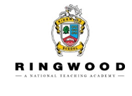
Secondary E-Safety Smart
Clare Adams
Deputy Headteacher/Designated Safeguarding Lead/IT & Computing Teacher

Slide 37
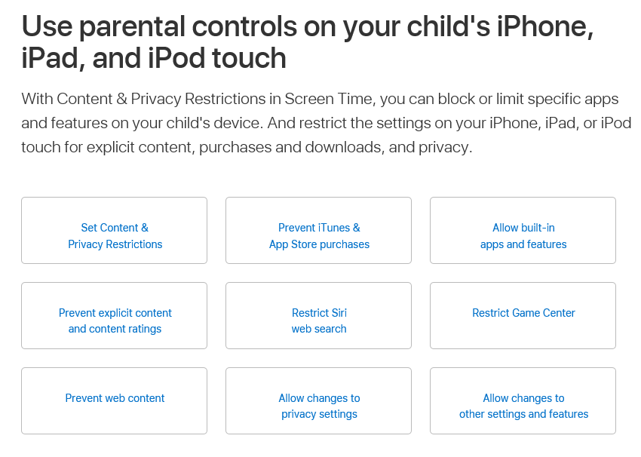
If you are using Apple

Slide 38
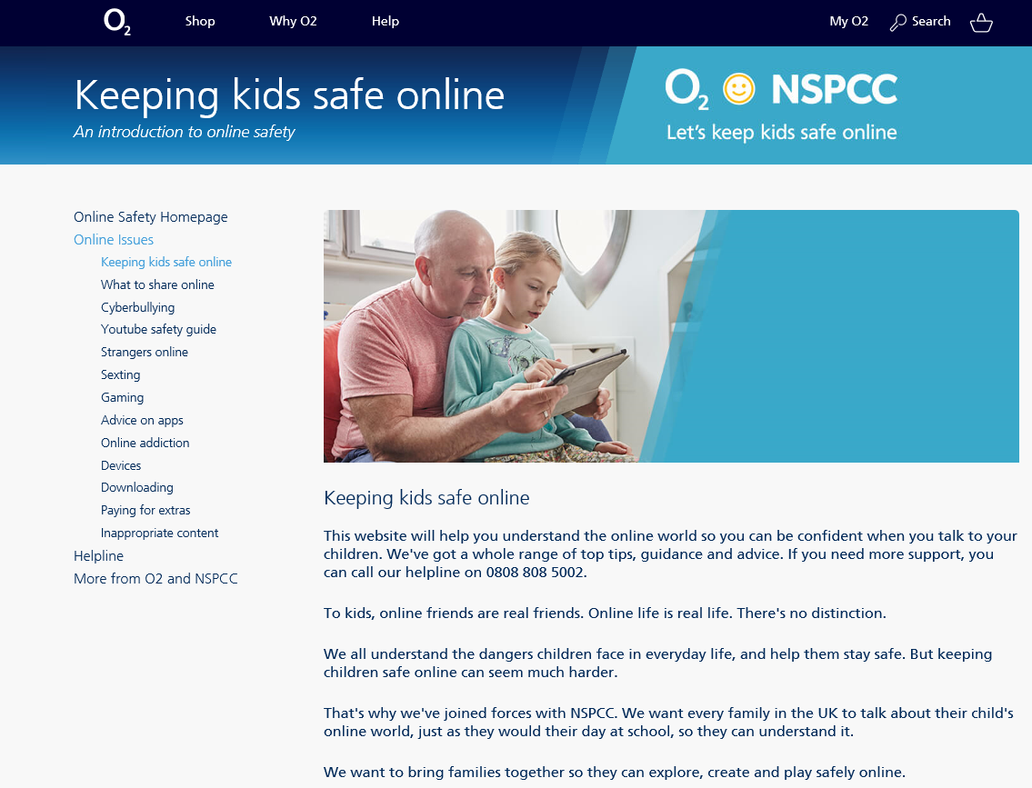
www.o2.co.uk/help/nspcc/child-protection

Slide 39
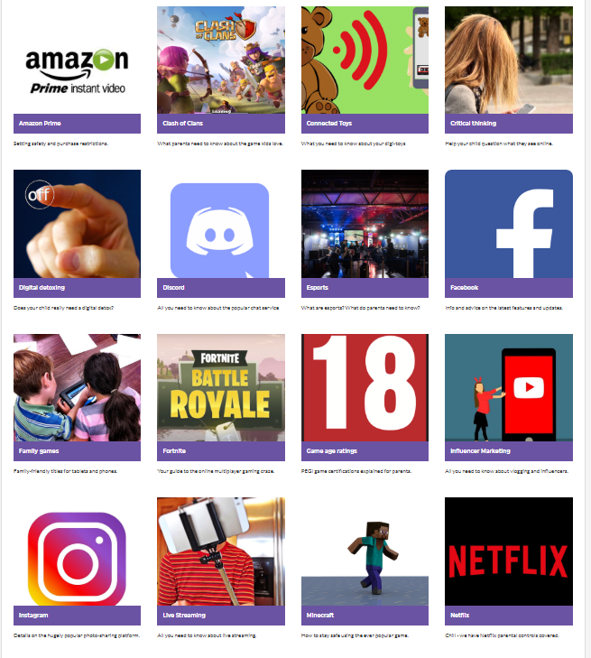
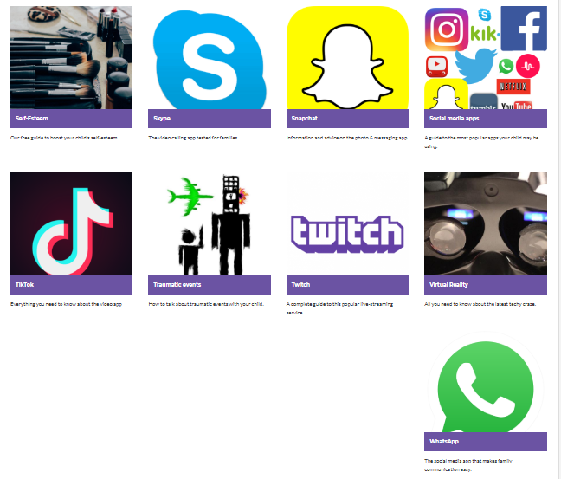
Most apps you need to be 13 or over to download

Slide 40
Top Tips
Start discussing online safety at an early age’
‘If you wouldn’t do it face to face - Don’t do it online’
‘Teach them to beware of strangers bearing gifts’
‘Once you’ve written something you can’t delete it’
‘Never, under any circumstances, browse unaccompanied’
‘Become friends and contacts in your child’s social media’
‘Just apply standards you adopt offline to the online world’
‘Anything that is put online should assumed to be permanent’
‘Learn about something yourself if you don’t know’ Ignorance is no excuse

Slide 41
Once you’ve seen it… you can’t unsee it
Letting your child use your phone when adult messages come through can be a problem
Older siblings can expose younger children to content that isn’t appropriate
YouTube Safety = YouTube Kids
Has your child ever said something, and you've wondered where they picked it up? With child-friendly apps like YouTube Kids, you can make sure their influences are the right ones

Slide 42
What do we see at Secondary?
Life changing issues caused by the sharing of sexually explicit images – Sexting
Inappropriate messages sent to groups about suicide – KMS
Police involvement when videos are taken and then shared

Slide 43
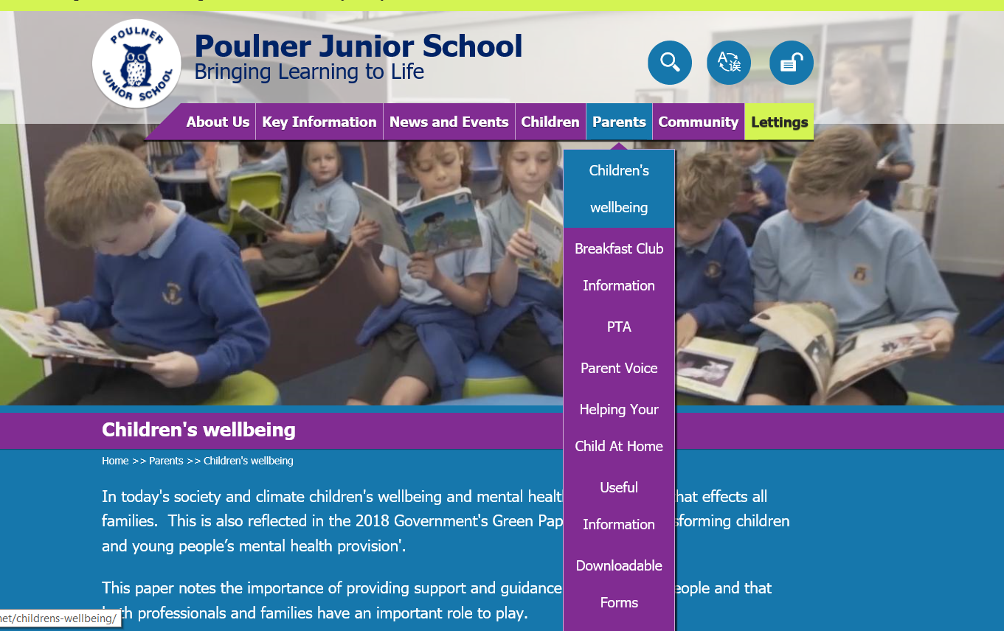
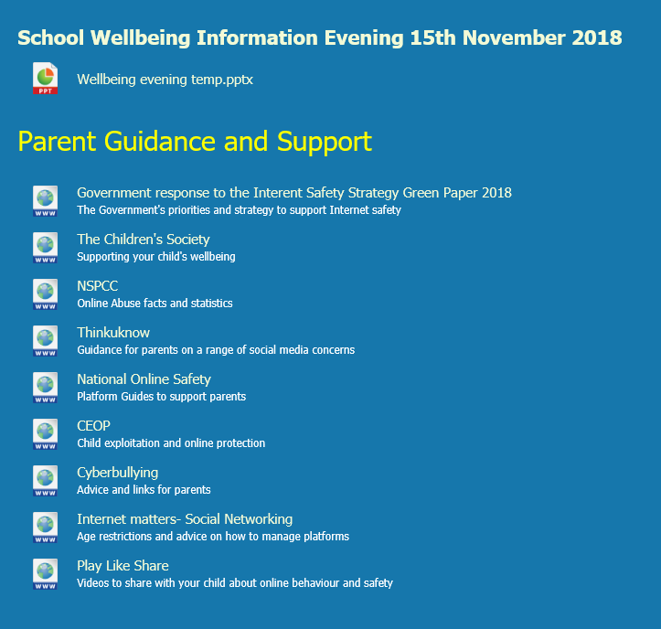
Where can I find some of the resources you’ve talked about?

Slide 44

Final thoughts, to summarise

Slide 45
Any questions?
We hope you’ve found the evening useful and we are here to help you through this unknown time! We’re in it together!

