Slide 1
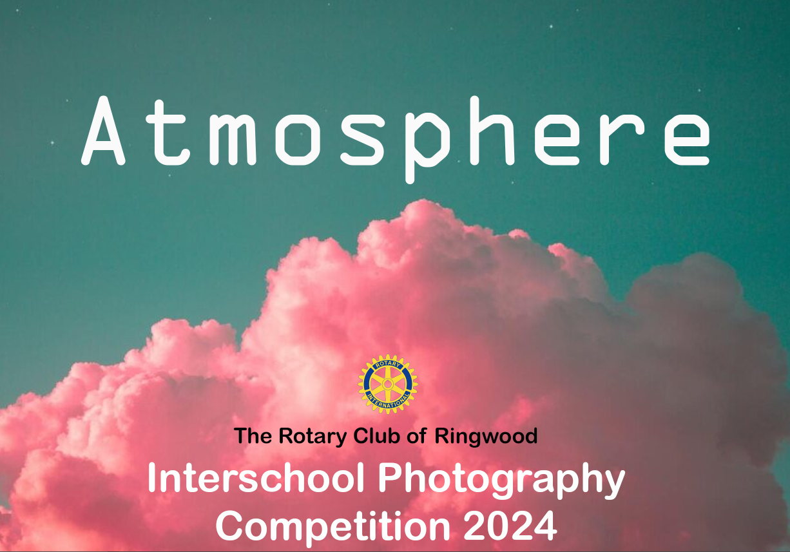


Slide 2


This year’s challenge is to create a photograph which reflects the theme -
A theme which gives you the opportunity to explore your creativity and can be interpreted in a wide range of different ways.
Entries to: photocompetition@ringwood.hants.sch.uk

Slide 3

An Interschool Photography Event
This fantastic competition is now in
its 12th year and this year involves 18 schools across Dorset, Hampshire and Wiltshire.
There are various age group categories running from 4 -18 years so everyone can get involved . This also includes a category for parents/carers and teachers.
The award ceremony and a professional exhibition of the winning entries is then showcased at Ringwood School in The Barn. The exhibition will then move onto the New Forest Heritage Centre in Lyndhurst, until Friday 7th June.
Last year we had over 1000 individual entries!

Slide 4
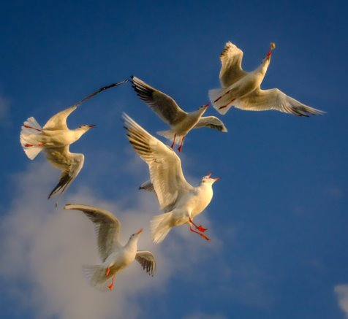
Here are examples of winning entries
from previous themes…
2023 Overall Winner – Theme – Movement

Slide 5
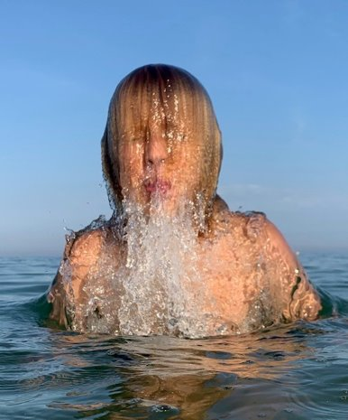
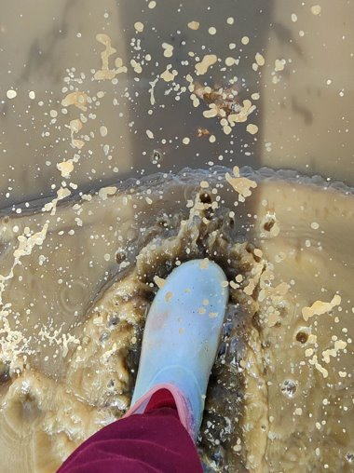
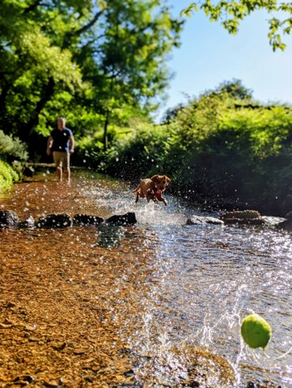
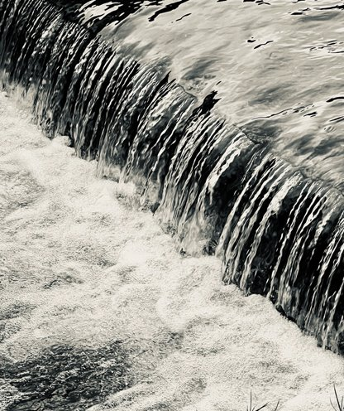
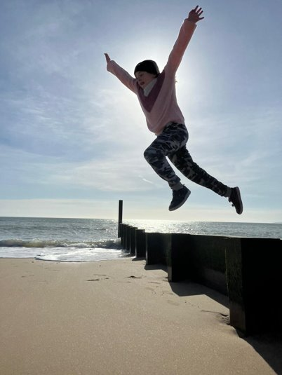
Short Listed entries from the last competition - Primary

Slide 6
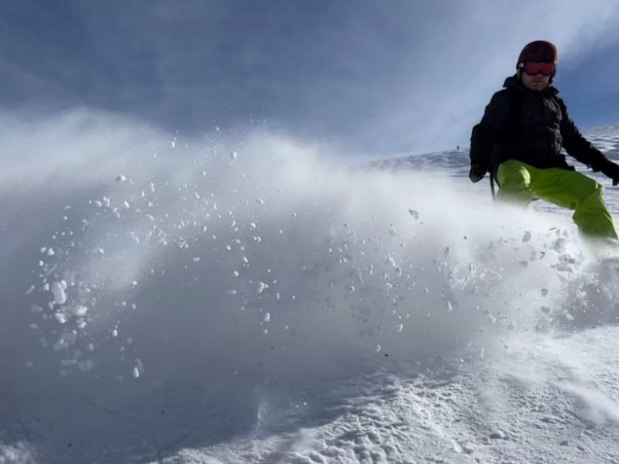
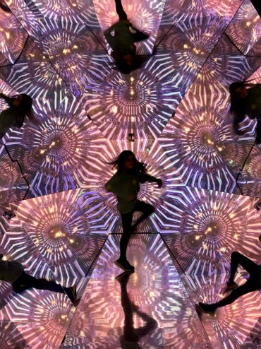
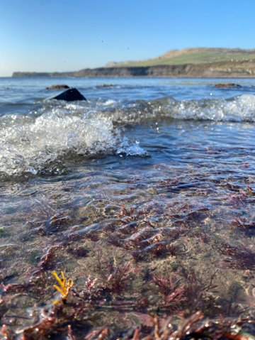
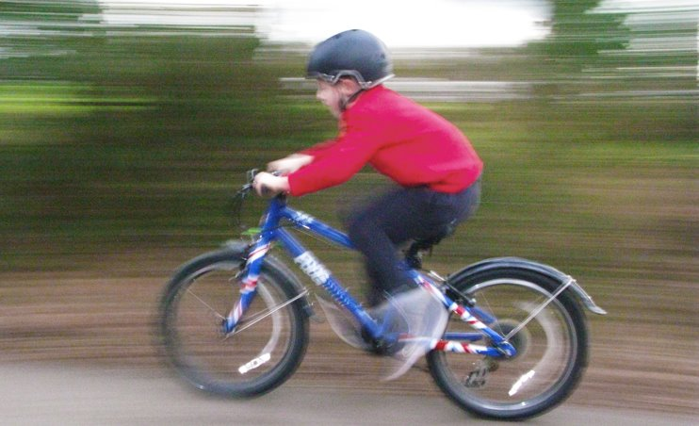
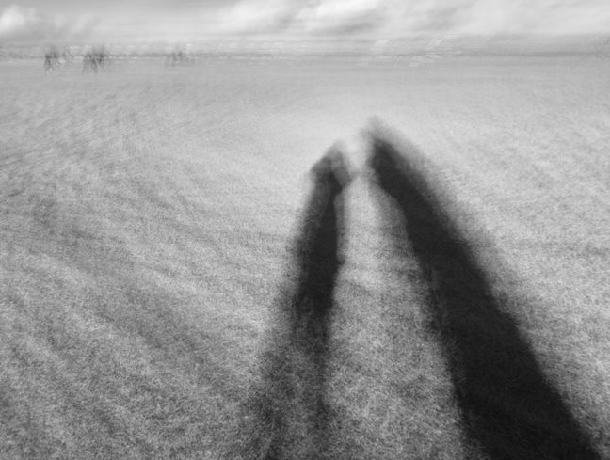

Slide 7
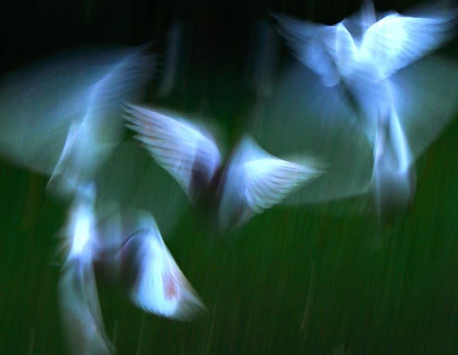
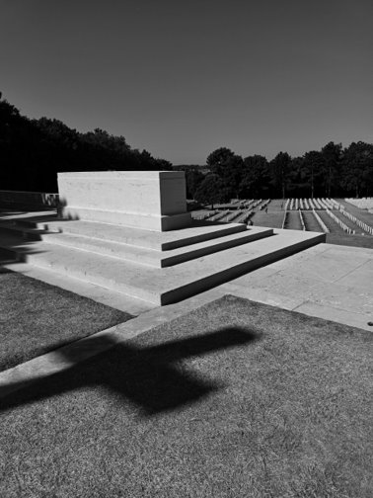
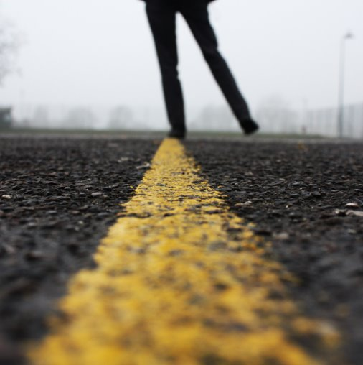
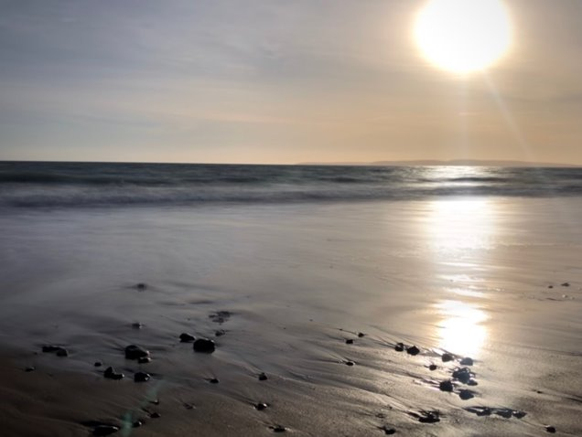

Short listed entries from the last competition - Year 7-10

Slide 8
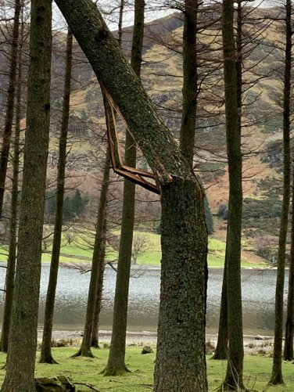
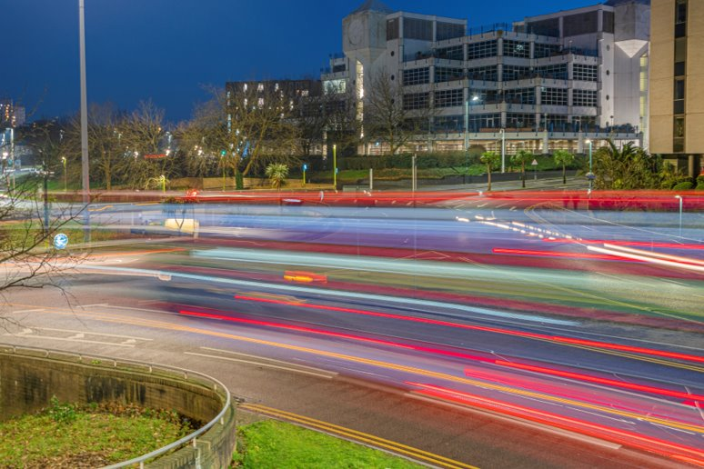
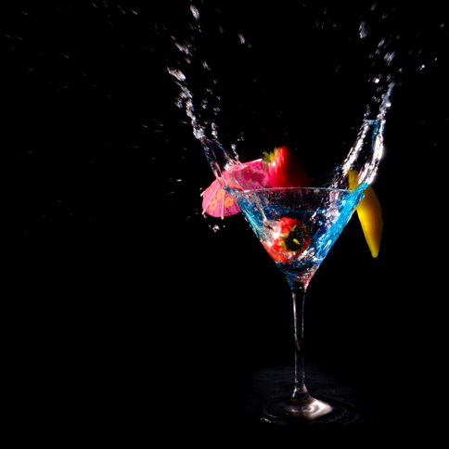
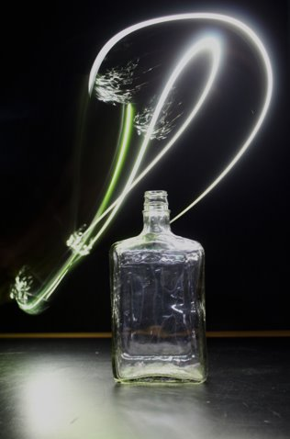
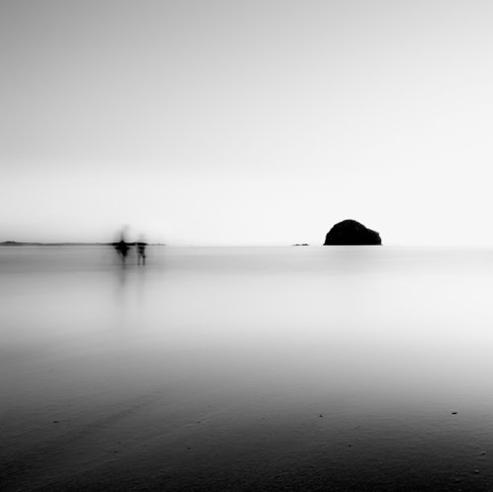
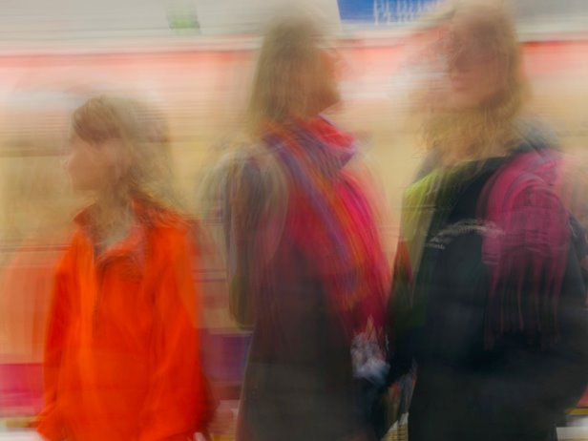

Slide 9
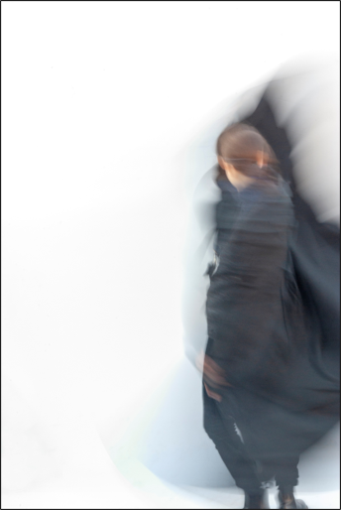

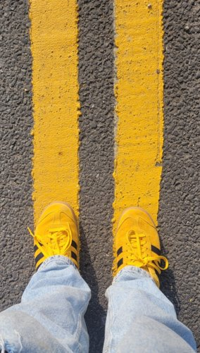
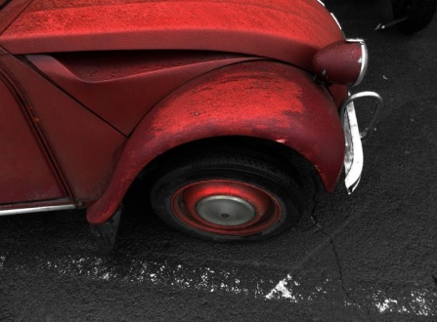
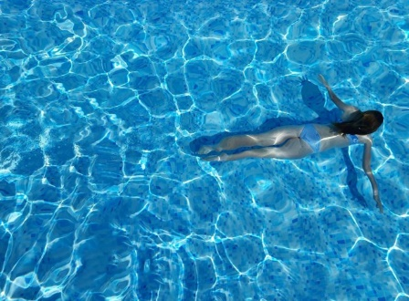
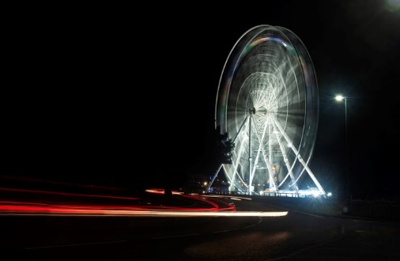
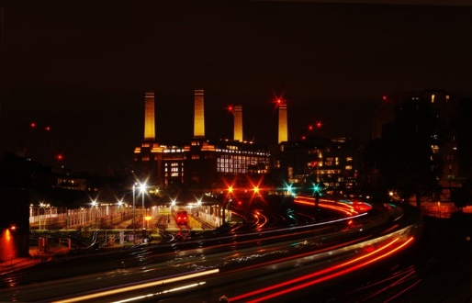
Short listed entries – Year 11 - 13

Slide 10
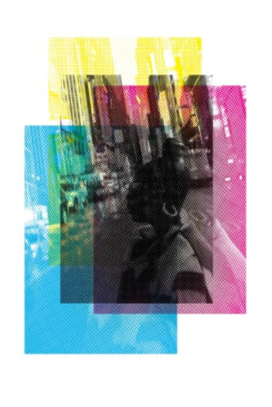
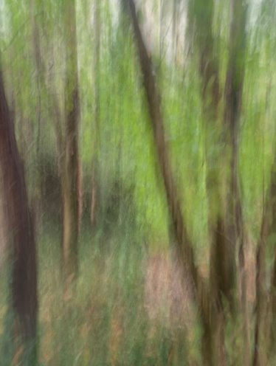
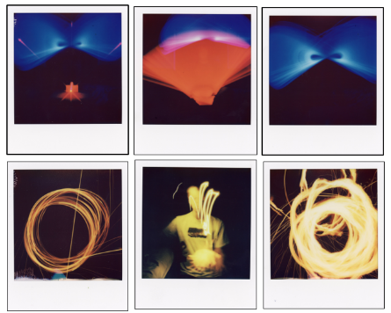
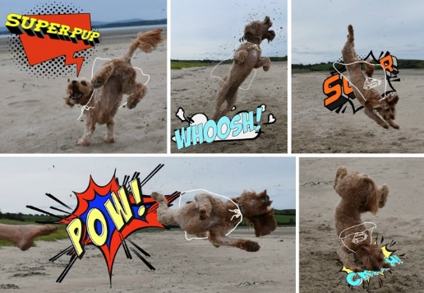
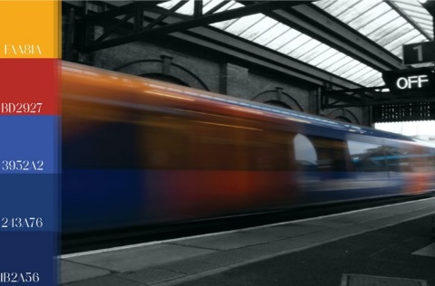
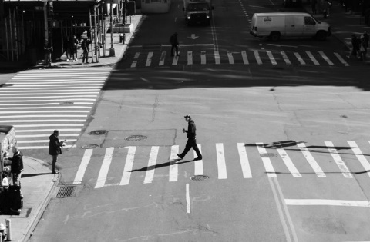

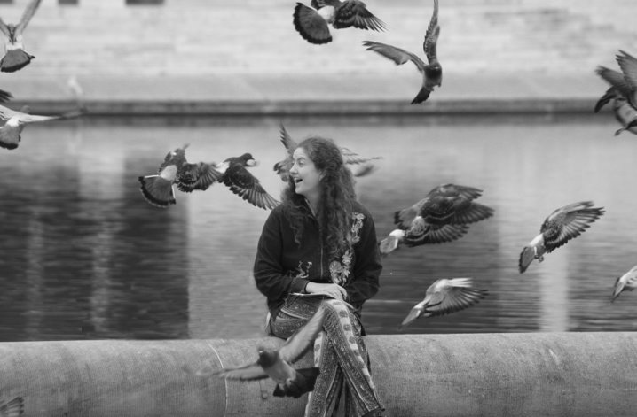

Slide 11
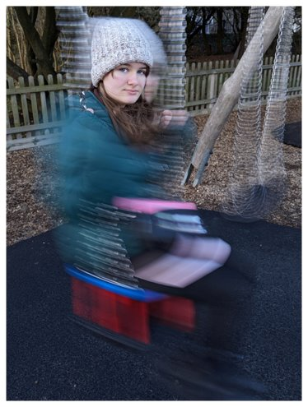
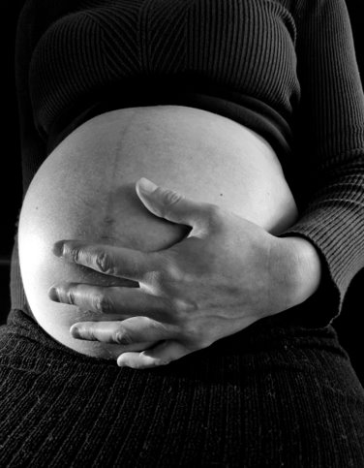
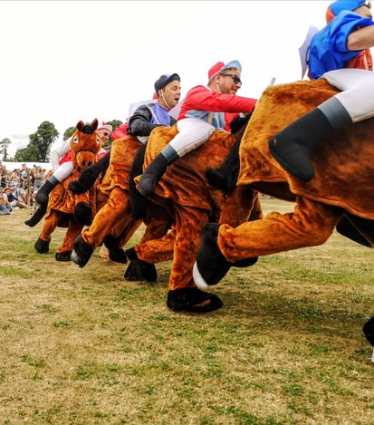
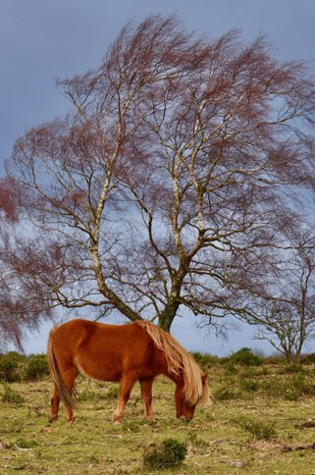
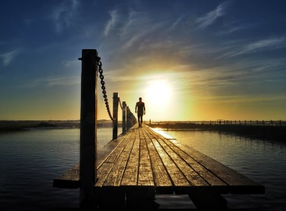
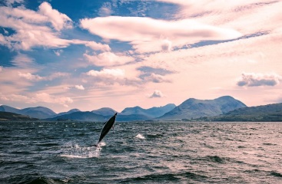
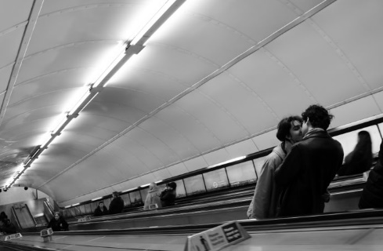

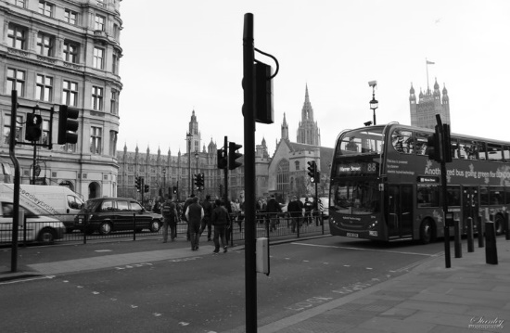
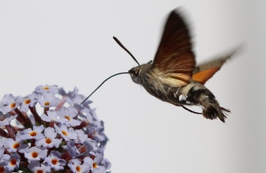
Short listed entries – Staff and parents

Slide 12
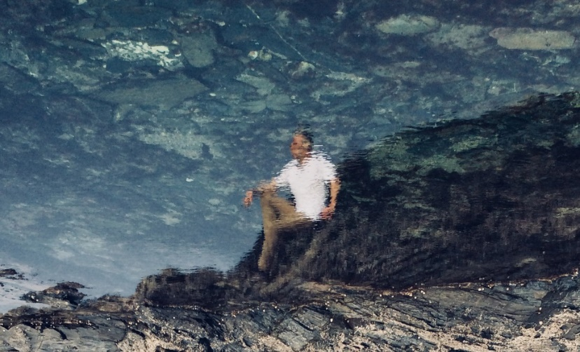
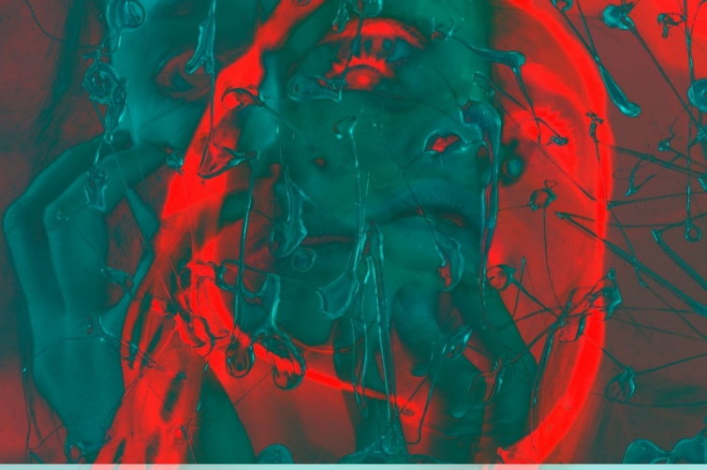
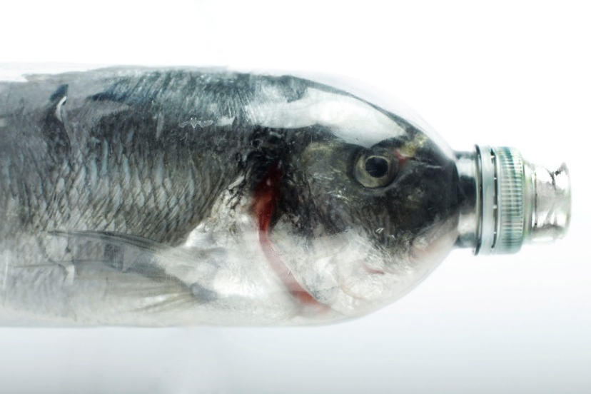
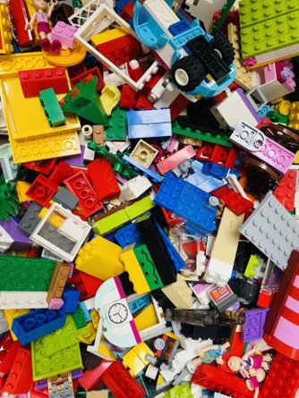
2018 Overall Winner
2019 Overall Winner
2020 Overall Winner
2021 Overall Winner

Slide 13
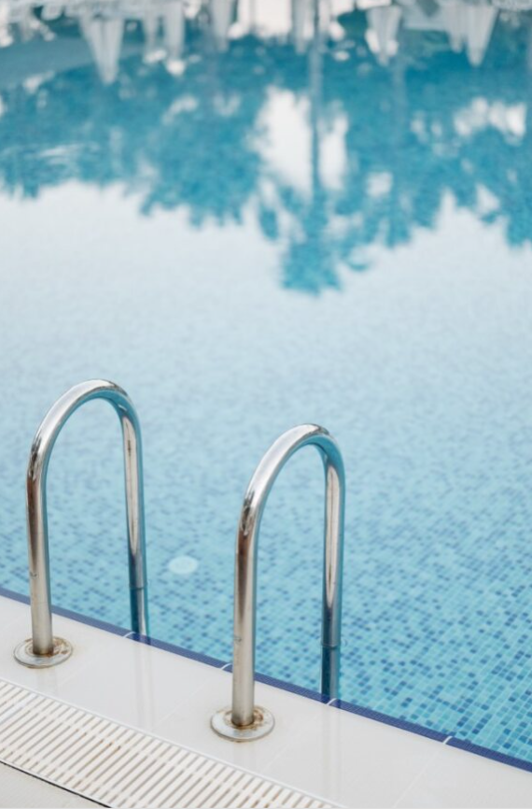
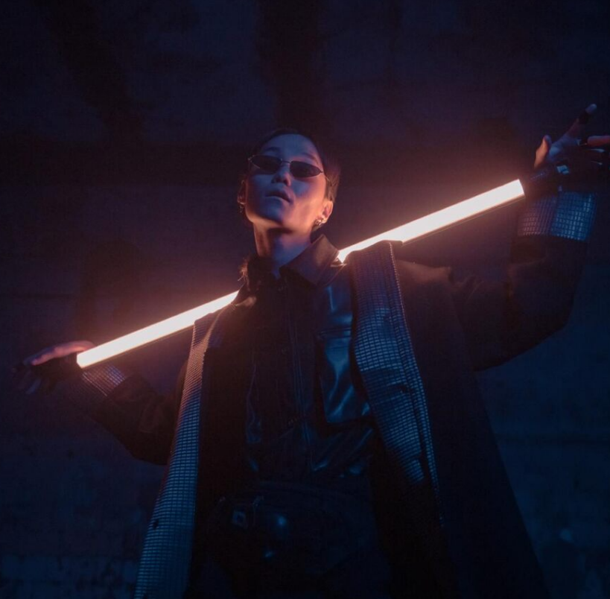



What does atmosphere mean?
Atmosphere -
NOUN
the character, feeling, or mood of a place or situation:
a feeling that a place has of being pleasant and interesting or exciting:
Key words - ambience, vibe, mood, tone, climate or feel.

Slide 14





What could Atmosphere mean?

Slide 15







Slide 16
Age Categories
School Years 4 - 6
School Years 7 - 10
School Years 11- 13
Adult – Teacher or parent/carer

Slide 17




Prizes
Winning entries will receive prizes of cash vouchers and photographic books.
The overall winner will be awarded a DSLR camera.
Prizes and certificates will be given at the Exhibition Awards Evening At the exhibition overall trophy winners and runners up will be announced in each age category.

Slide 18

How do you choose what to
photograph?
Think about choosing an interesting subject
BUT more importantly think about your composition, your timing, your use of light to make an engaging photograph.
The most interesting person/scene or thing in the world can be photographed in a really uninteresting way – or the most inspiring!

Slide 19
Competition Rules
Each student/ teacher and parent can enter only 3 images each.
Entries should be submitted as JPEG files attached to an email
Each individual JPEG photograph file should be retitled with your name, photo-title, school and age group and sent attached to an email photocompetition@ringwood.hants.sch.uk
Please make sure that your images are a good enough file size
and quality to enlarge to A2 size for exhibition - ideally 2MB
No AI is allowed to be used
With over a thousand entries entered into this competition, it’s really important you label your photographs clearly.
The deadline for entries is Friday 23rd February 2024.

Slide 20

If you have any other questions, please ask staff at your school or email Mrs Emily Weston (Course Leader Photography at Ringwood School)
Good Luck and happy snapping!

